Slide 1
Toasting with deities and hungry ghosts
A cultural Discourse Analysis of Social Drinking in Bhutan
Dorji Wangchuk
University of Macau

Slide 2
Abstract
Examines social drinking in a remote rural community Bhutan from communication perspective.
Drawing from the cultural view of communication (Carey, 1975) and using cultural discourse analysis (Carbaugh, 2007), this paper argues that drinking is a culturally-sequenced communication event - loaded with symbolisms and meanings that celebrate community, social order and interdependence

Slide 3
Bhutan: Context
  Small country 38,000 sq km, pop. 700,000
  Totally mountainous, 19 ethnic groups
  Modernisation started in the 1960s
  61% of Bhutanese are farmers or lay monks
  Traditional life revolves around farms, family and prayers
  Constitutional monarchy and parliamentary democracy since 2008

Slide 4
Bhutan: Context
  Three generations with three worldviews (Phuntsho, 2013)
  First - pre-Buddhist belief system of all-powerful nature and deities
  We share the world with non-human denizens, wandering spirits and hungry ghosts
  Second, Buddhist view of ‘power of mind’ as the source of fear or liberation
  Third, scientific view that attempts to explain the world with logic and rationality.

Slide 5
LIT review
  Studies focus on alcohol consumption in Bhutan as a discourse of health or social ills
  Pre-Buddhist accept alcohol as gift from the Moon God (Dorji, 2012)
  Alcohol as a medicine that saved the Gods from the demi-gods during a war that lasted years
  The most popular Buddhist master in Tibetan Buddhism is Drukpa Kuenley, who celebrated women and wine as conduits for his enlightenment

Slide 6
theory
  Framed within the traditions of ethnography of communication (Hymes, 1972) and specifically, the concept of communication ritual, which is ‘a structured sequence of symbolic acts, the correct performance of which constitutes homage to the sacred object’ (Philipsen, 1987)
  Overall assumption:
    Communication is a “symbolic process whereby reality is produced, maintained, repaired and transformed” (Carey, 1975)

Slide 7
method
  Cultural Discourse Analysis (CuDA) - a method for investigating communication ethnographically
  CuDA assumes that “everywhere there is communication, a system is at work; that everywhere there is a communication system, there is cultural meaning and social organization, and thus, the communication system is at least partially constitutive of socio-cultural life” (Carbaugh, 1995)
  Using CuDA, we identify, describe and interpret culture-specific symbols, symbolic acts, and norms that shape the communication practices and events

Slide 8
Data
  An opening sequence of a social drinking session in Lamga village, Athang, Wangdue
  The conversation is taken from field notes of participatory observations during a religious event at the community temple
  Access to this event comes from my sponsorship in building this temple. Being a part of the community.

Slide 9
Research site
Lamga is a small community of 11 households
The inhabitants are farmers and cattle herders –practicing sustenance farming
They are mainly Vajrayana Buddhists – where both rituals and prayers are conducted
The children are the first generation to get modern education

Slide 10
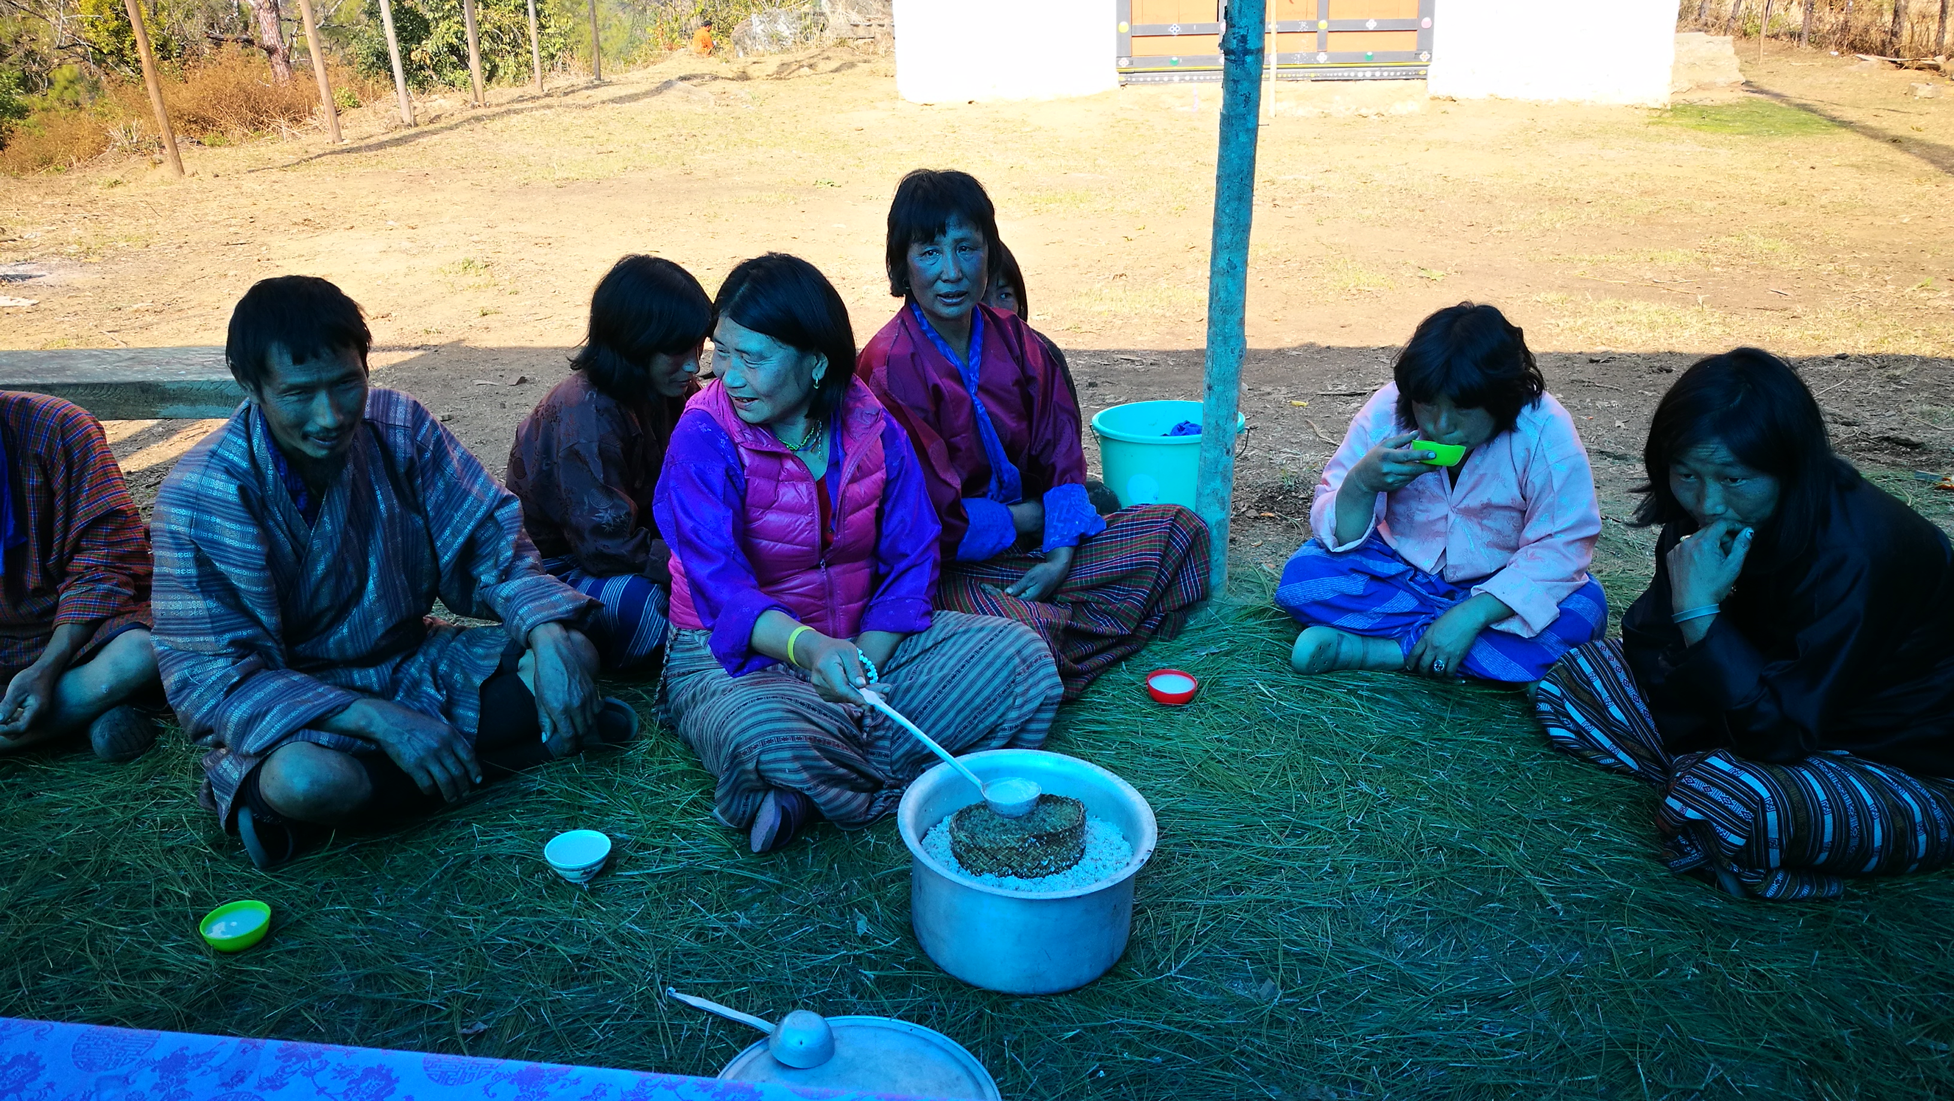
Transcript
(LH opens the lid of the pot, scoops a tiny portion and drops it at the side of the pot. And then extends the first invitation to the man.)
LH: Azha, zhay!
Uncle, please have some.
M: Mizhu mena
Really, Should I accept?
LH: Zhey, azha, zhey!
Please have, uncle. Please have.
L2: Nyim dhin zueni bedho
The Sun is almost down.
M: Nyim dhi lha ghi gu lay ra may. Einru zhu chay gye.
The Sun is still over the mountains. But, if you insist.
M
Lady of the house
(LH)
(L2)

Slide 11
Transcript
(M takes out a cup from his gho (national dress of Bhutan) and stretches out his arm. LH pours till the brink of the cup. Waits to refill it again. M dips the tip of his ring finger into the drink and flicks it in the air and then takes a sip. Stretches out the cup towards LH for the second serving as customary. LH refills it again)
M: Laso, tubay tubay
OK. Enough! Enough!
(M takes a sip again and carefully lands the cup on the ground)
LH: Zhey la. Datoh di no chowa dhin jo ma ren. Golay bay zhey la.
Please have. After all, it is still early to regroup back the cattle. So please have it slowly.
M: Dari chhim na gaya mi sa. Joba lok jo go. Nyim zeu chi, choeb ting su sha bay, no chowa jo goh
Today there is no one at home. So, I must return there. As soon as the Sun is down, I must remove the sacred water [from the altar] and then go and collect the cattle.

Slide 12
Transcript
(LH then turns to the lady on her left and stretches a ladle full of ara. LH doesn’t say anything to her and simply waits. L2 hesitates to accept. She giggles)
LH: Ya! Joba! Joba! Thungo bahlu, ngyen khu tsugo bahlu. Dattara gutoh kha lu dawu
Here! Quick! Quick! You have to drink and also put on a public drama. Else I’ll pour on your head
(LH threatens with a smile. Everyone laugh. L2 is served. And one after another all the guests are served. Others present receive without any act of refusal.)
M: Aue, chhe ra yang mezhey bu?
Won’t you drink with us, Aue?
LH: Chang chek dhi lho sum ya si. Drim rang mi ga yay.
It’s been three years since I quit. No I don’t even like the smell.
M: Tendrel ghi tholay bay, atsi tsi zhey ni mey
Please have a little - as a tendray
(LH takes a drop on her palm and licks it.)
The session continues for over two hours

Slide 13
Descriptive
Placing a drop at the side of the pot
Using kinship address (e.g. Azha – uncle)
The ‘refusal’ – avoid poison-givers
Getting served – the order and the sequence
Sun is almost down. Regroup the cows
Sun is down. Remove the sacred water
Drink slowly
Drink a drop - as a tendray

Slide 14
Cultural phrasings
          “golay bay zhey” (please have it slowly) – points to mindfulness. Being present
          rten ‘drel - Interdependence
          Goma (or Lama) ghi kadrin lay zhudho may la (thanks to our elders/superiors/lama, we are having good time – Gratitude. Contentment.

Slide 15
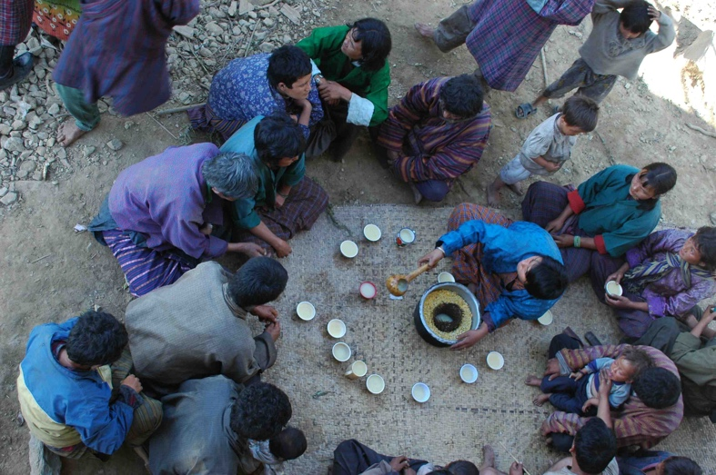
Interpretative
Meaning of being
  Be in harmony with the nature, the community and even the spirits
  Social identity more than self
  You are a ‘dot’ that completes the circle
Meaning of relating
  Existing relationships are reaffirmed and new relationships are formed
  You are related to everyone - including the space and the nature

Slide 16
Interpretative
Meaning of acting
    Correct performance of the cultural sequence procures membership (e.g. how to toast, how to accept, how to take the drink, how to end, and what to say)
Meaning of feeling
    Expressing gratitude
    Age, hierarchy and wisdoms are respected
    Recognise interdependence
Meaning of dwelling
    Acknowledge the place deity
    Nature-time community

Slide 17
Cultural NORMS
  Acknowledge:
    The deities and wandering spirits
    Age and hierarchy
    Altruism
    Gratitude
  Pride and personhood
      Act of refusal
  Concept of time is event/nature time

Slide 18
Cultural premises
  Community before self
    Your role in the community defines your identity
    You are part of the circle. You are a line or a dot
  The sacred time
      Besides the nature-time, people of Lamga are bound by the sacred time – the spiritual routines that dictate the day and the life
  The ‘sacred object’
    Being together is the celebration of interdependence
    The social order

Slide 19
CONCLUSION
  Social drinking in Bhutan analyzed as a communication ritual through CuDA within the cultural view of communication
  Drinking is cultural-sequenced, with its own code, symbols and meanings, where prior knowledge is essential, and which reveals membership, personhood, gratitude, interdependence and community.
  Three cultural premises: community before self, the sacred time, and the ‘sacred object’ of social order and interdependence
  As Bhutan gets more urbanized, westernized and gadgeted, what will be the communication ritual that will replace these practices to pass on these systems of beliefs and value?
  As the worldview gravitates towards the socio-scientific from shamanistic-Buddhist, what will be the “sense of places”?

Slide 20
Tashi delek
Dorji Wangchuk
University of Macau

Slide 21
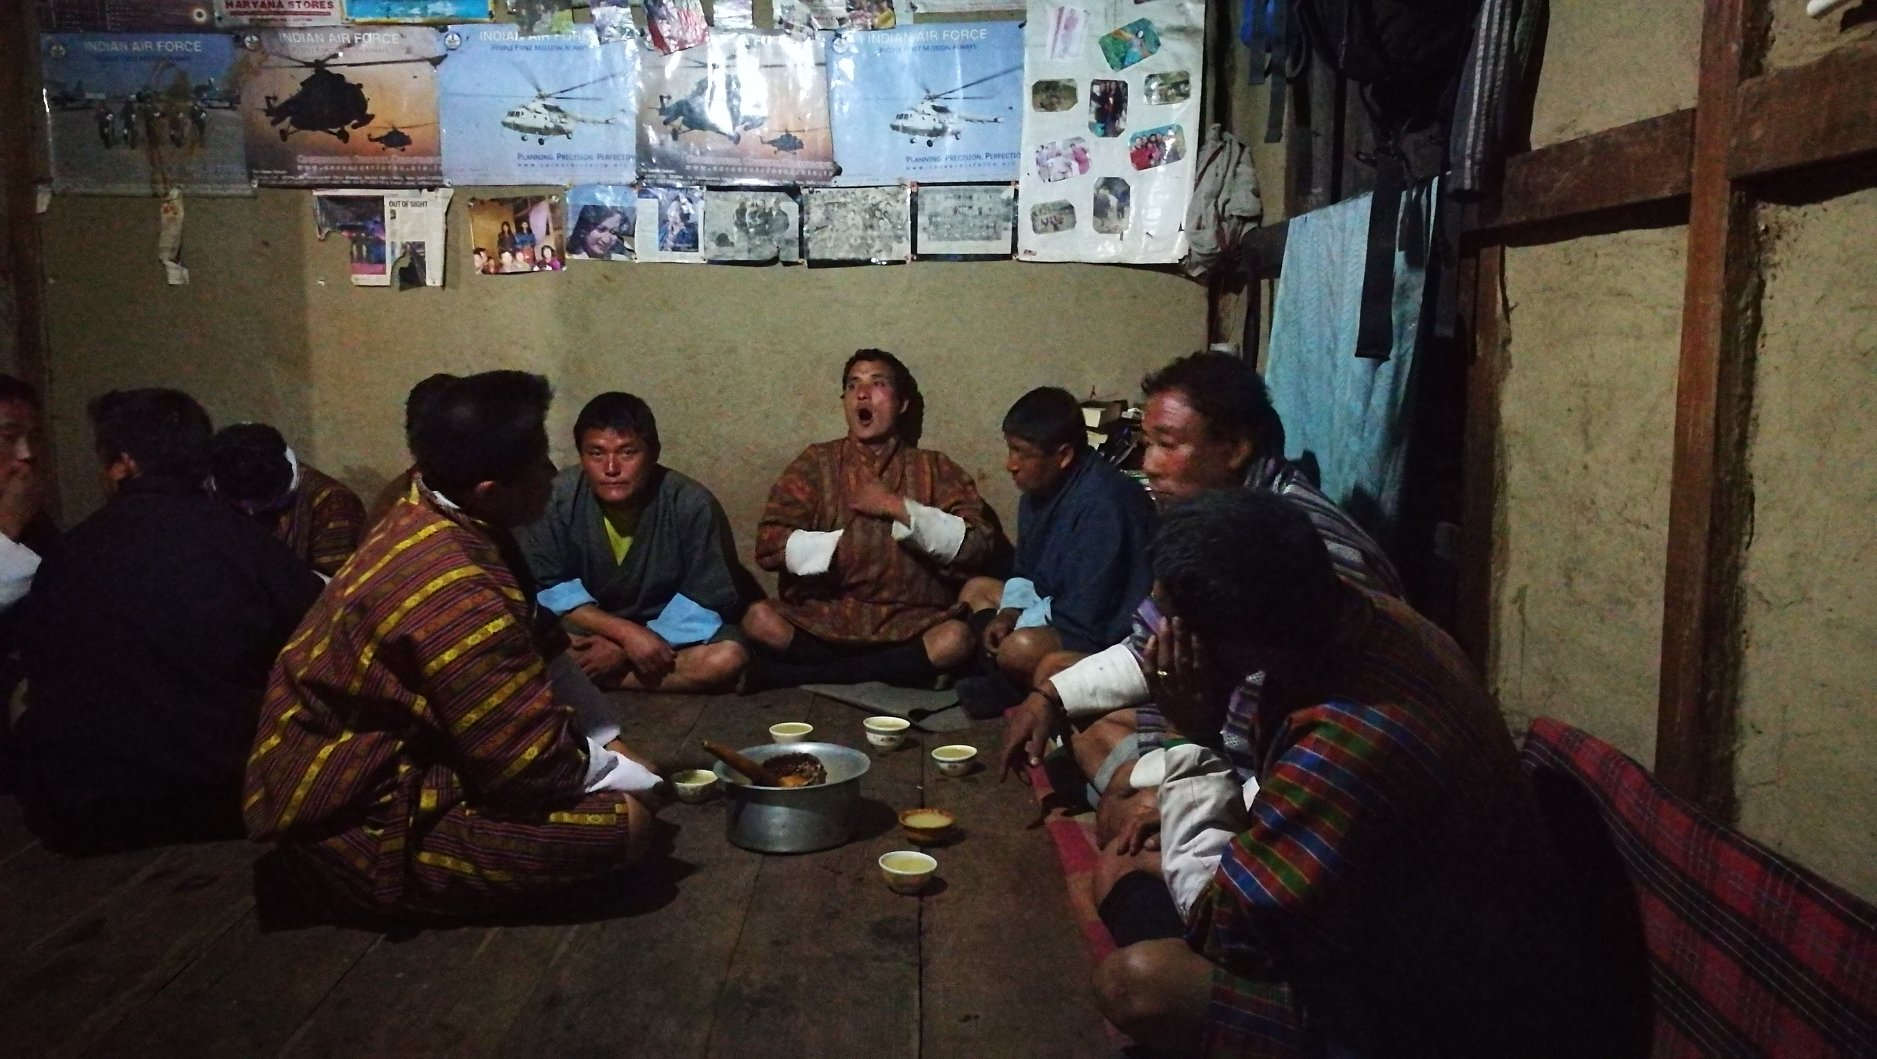
Example #2
  M1: OK! Whoever is not drinking, please step aside
      (Session starts, M1 offers to the M2)
  M2: (M2 pretends to refuse. Also looks at me)
  M1: Our guest doesn’t drink
  M2: Ok, then, let me be the VIP
  M3: Of course you are (Everyone giggles. LH pours till the brink. Waits. M2 takes a sip. Stretches the cup towards M1 who pours again and moves to the next oldest person.)
  M2: (looks at me) Thanks to you. We are having a great time.
  M3: Empty talks! You didn’t offer even a piece of the deer meat, where is the real gratitude? (Everyone laughs)
M1
M3
M2

Slide 22
Example #2
  M2: It’s been a while I didn’t cross Dolepchen. But someone I know did.
  M3: Jokes apart, it is thanks to our collective good karmic deeds that we have all managed to gather here today. Let’s pray that we meet again next year.
  (Everyone nodes in agreement. Meanwhile all have received their first round of drinks)
  M1: Sir! Are you sure you don’t want to even try a sip?
  (He makes me one last offer as a courtesy and when I reconfirm, he pours into his own cup)
  M1: Ok, then, our guest doesn’t want to drink, so let me drink his share too. (Everyone laughs)
  M3: No one doubts that you will do full justice
M1
M3
M2

