Slide 1


Education: back to the future
Dorji Wangchuk
University of Macau

Slide 2
Education: back to the future
Basic assumptions
Vision of GNH is about contentment, balance, wellbeing
Wellbeing Tools for Teachers
Education is a preparation of life
We are lost
Self-Curiosity
Mindfulness
Community
Contentment

Slide 3
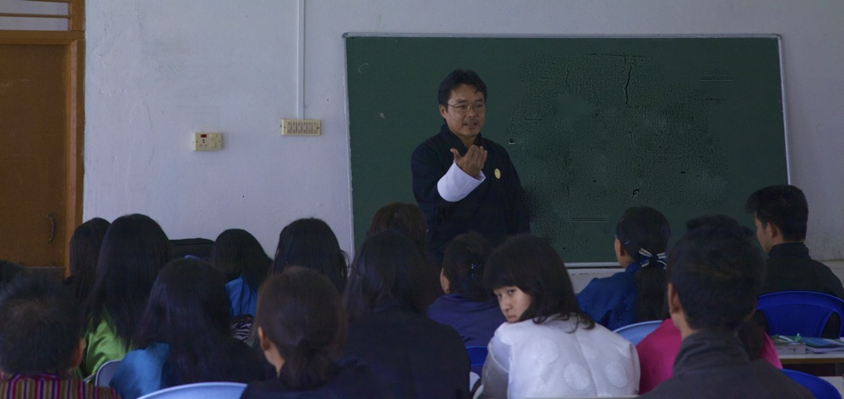
My story begins in 2013

Slide 4
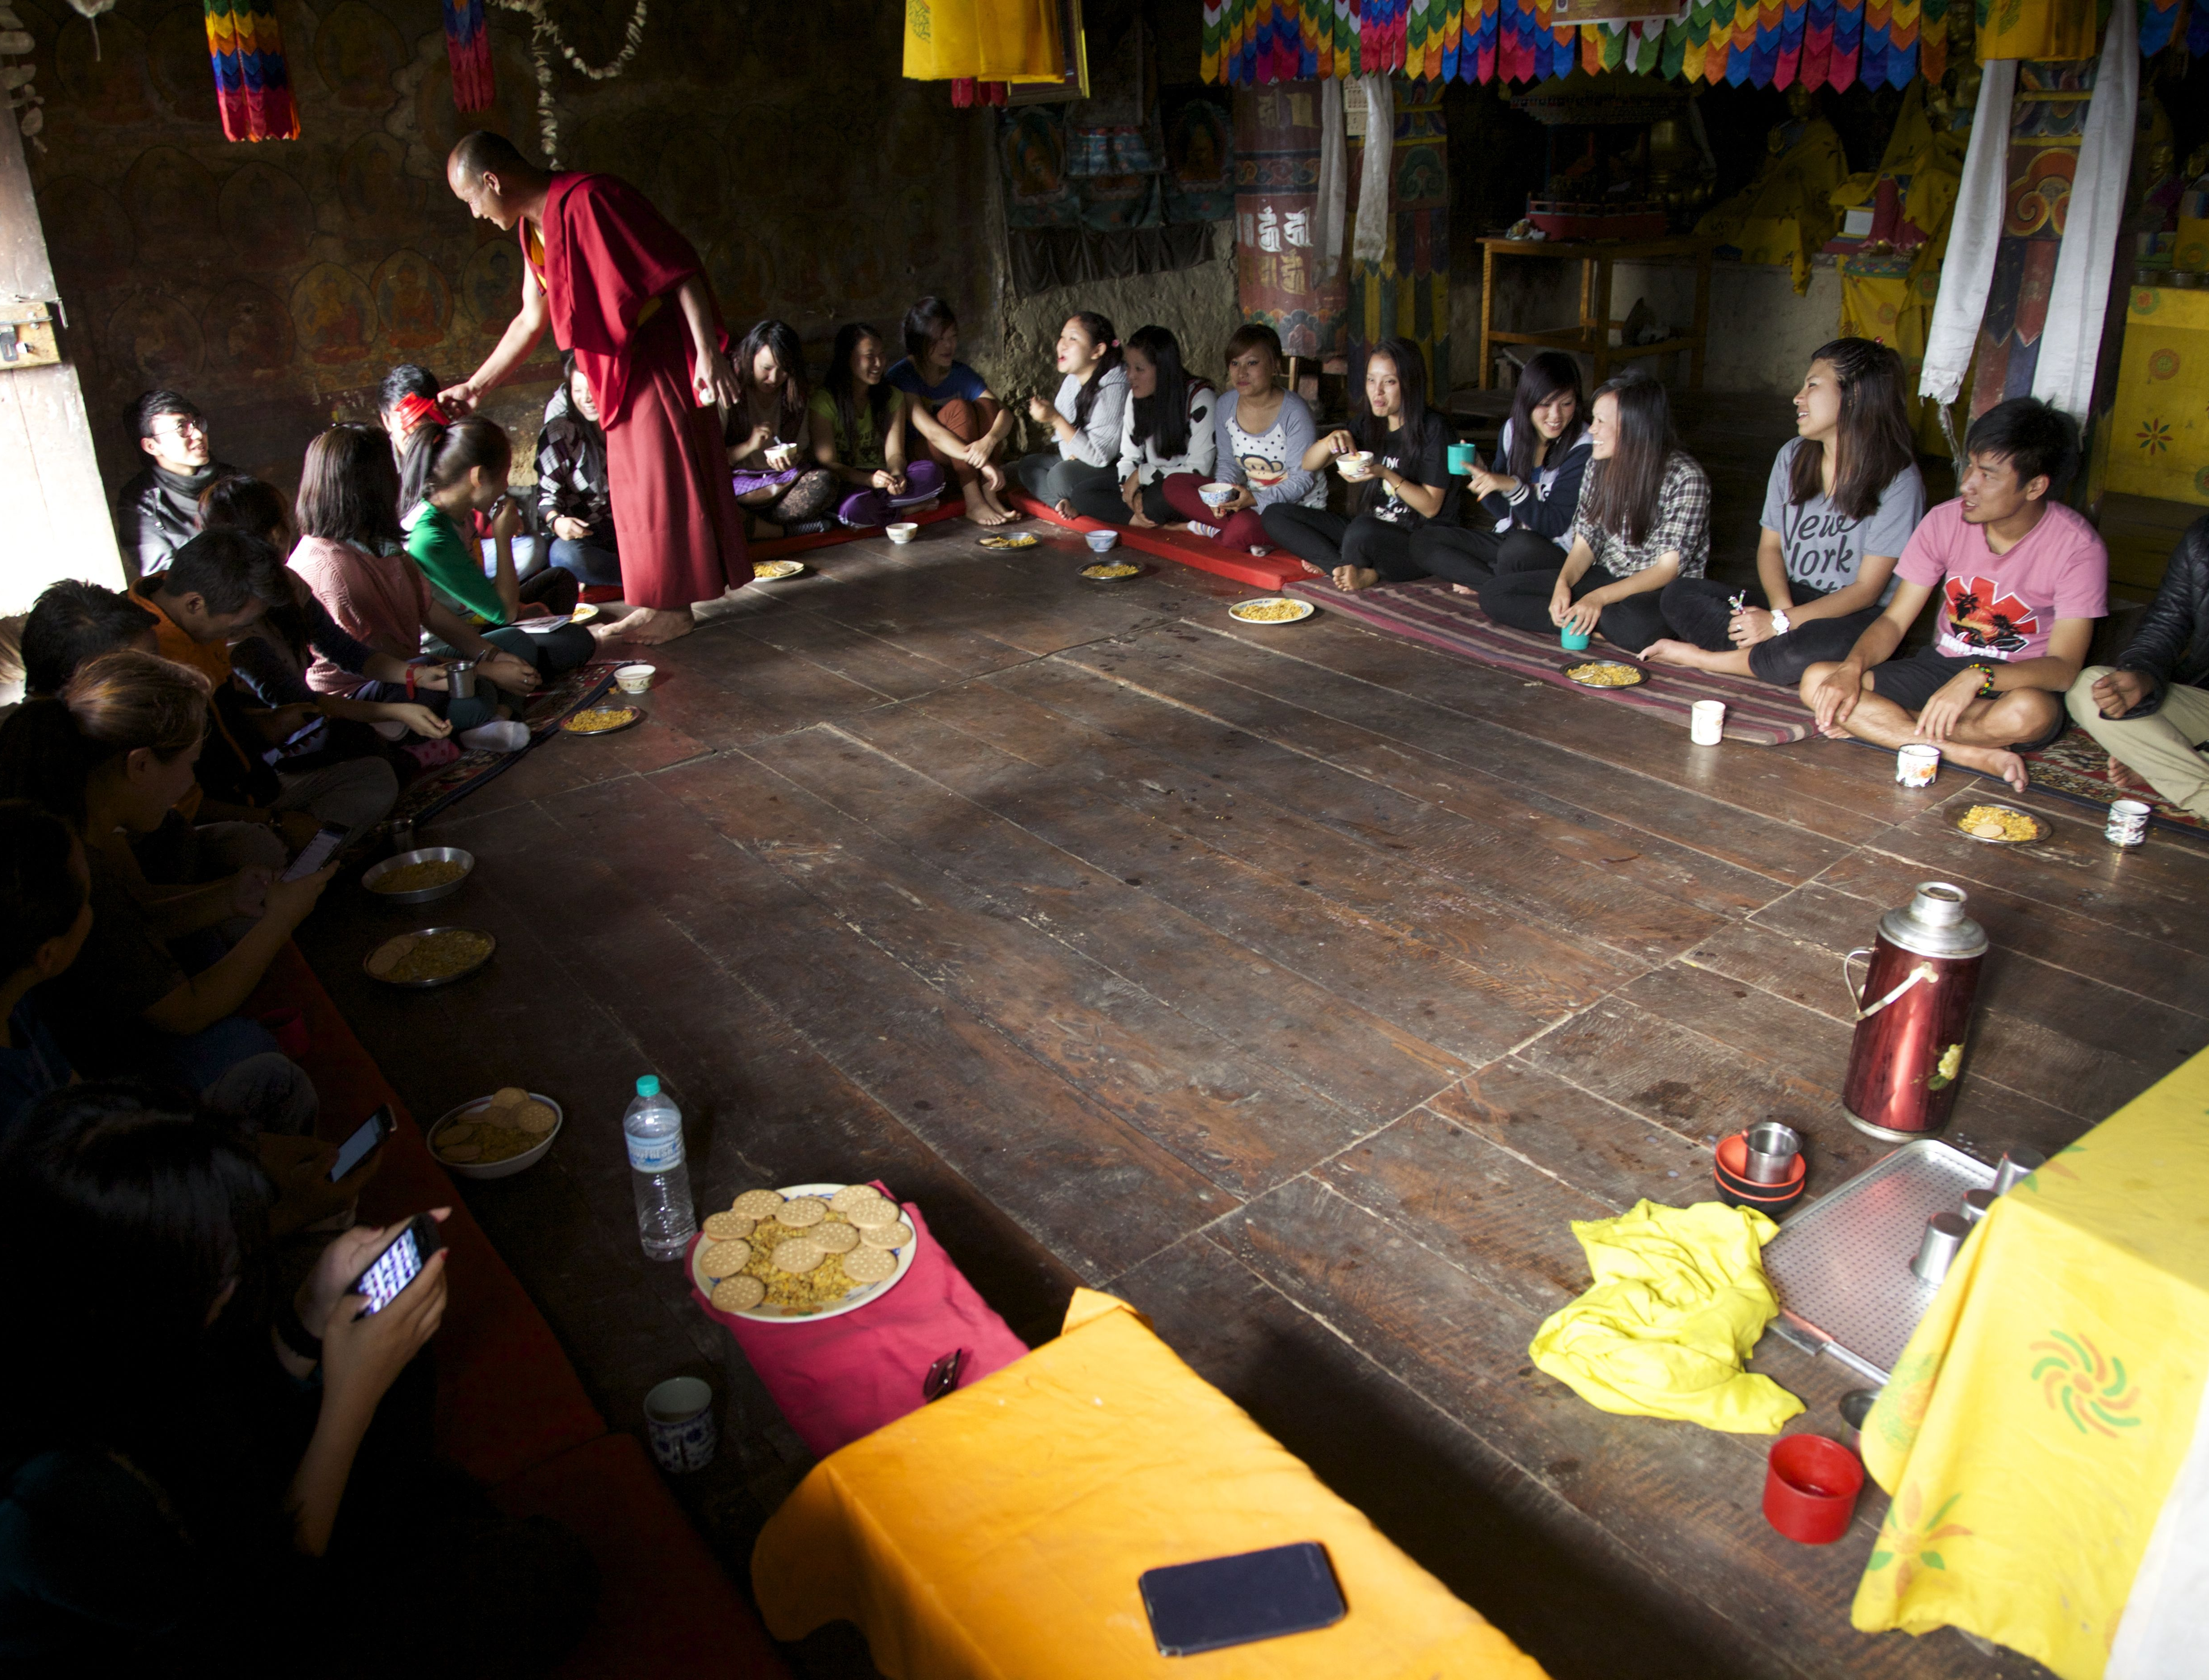
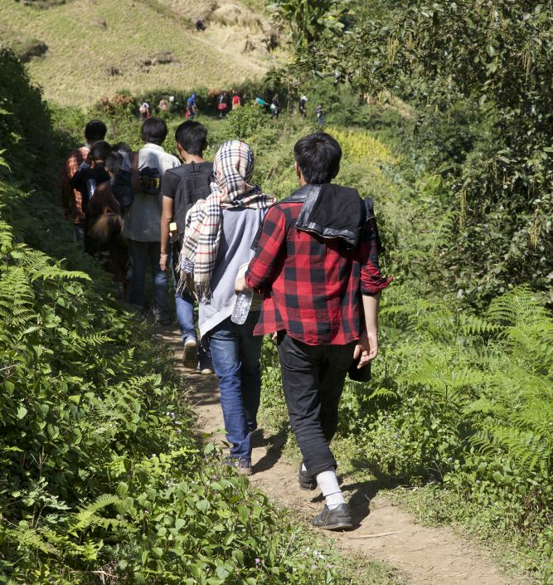
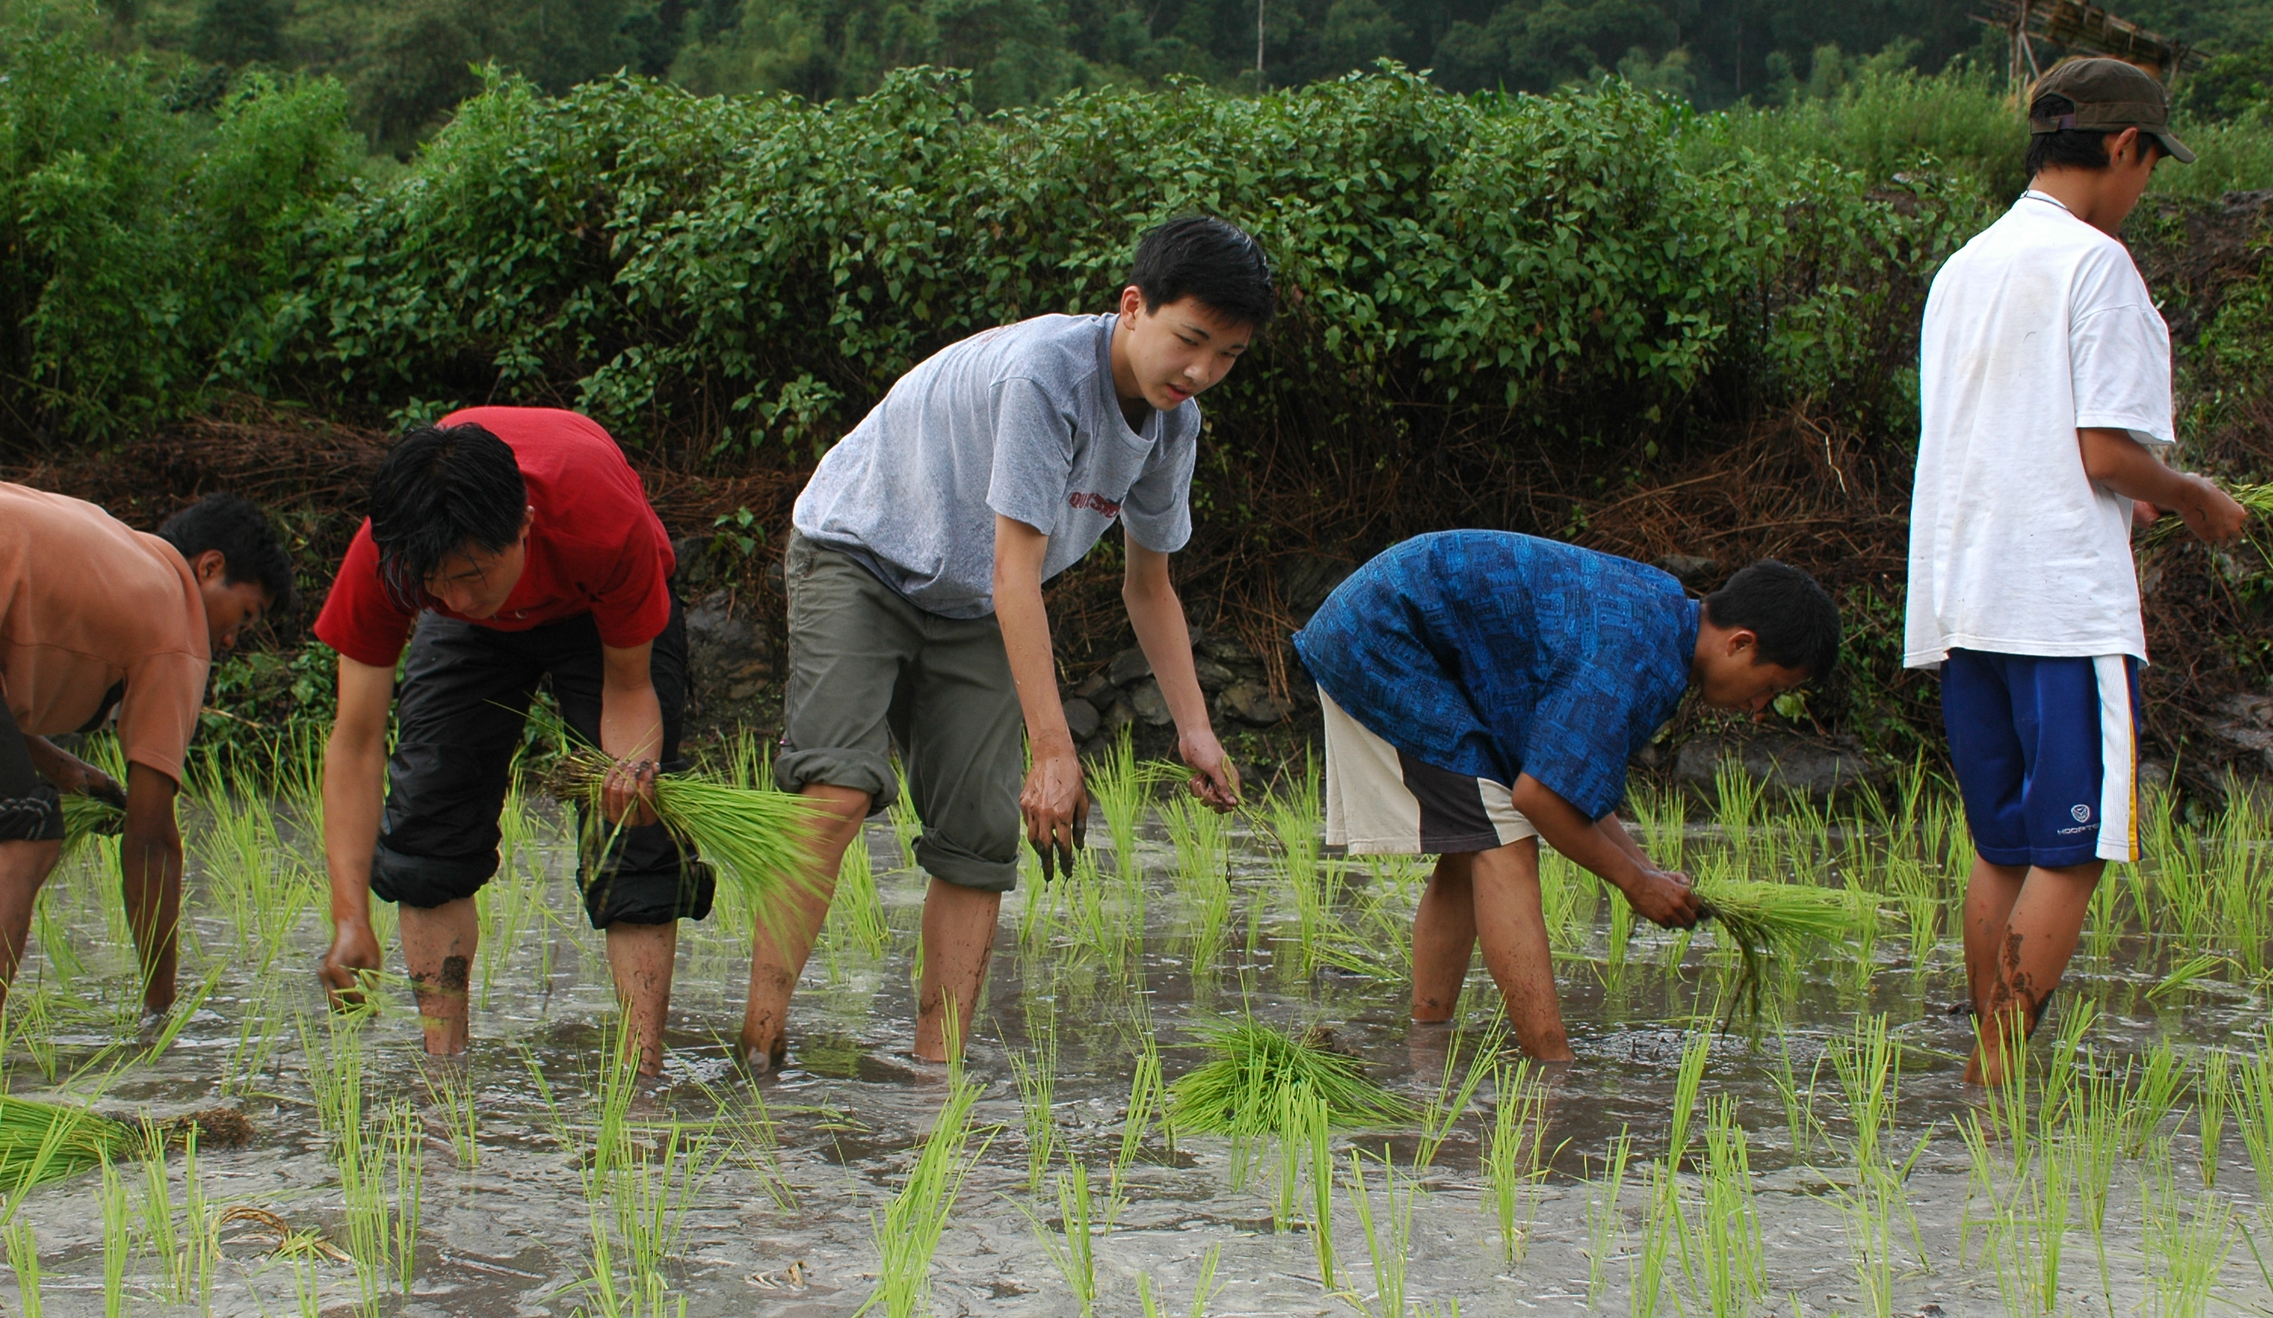
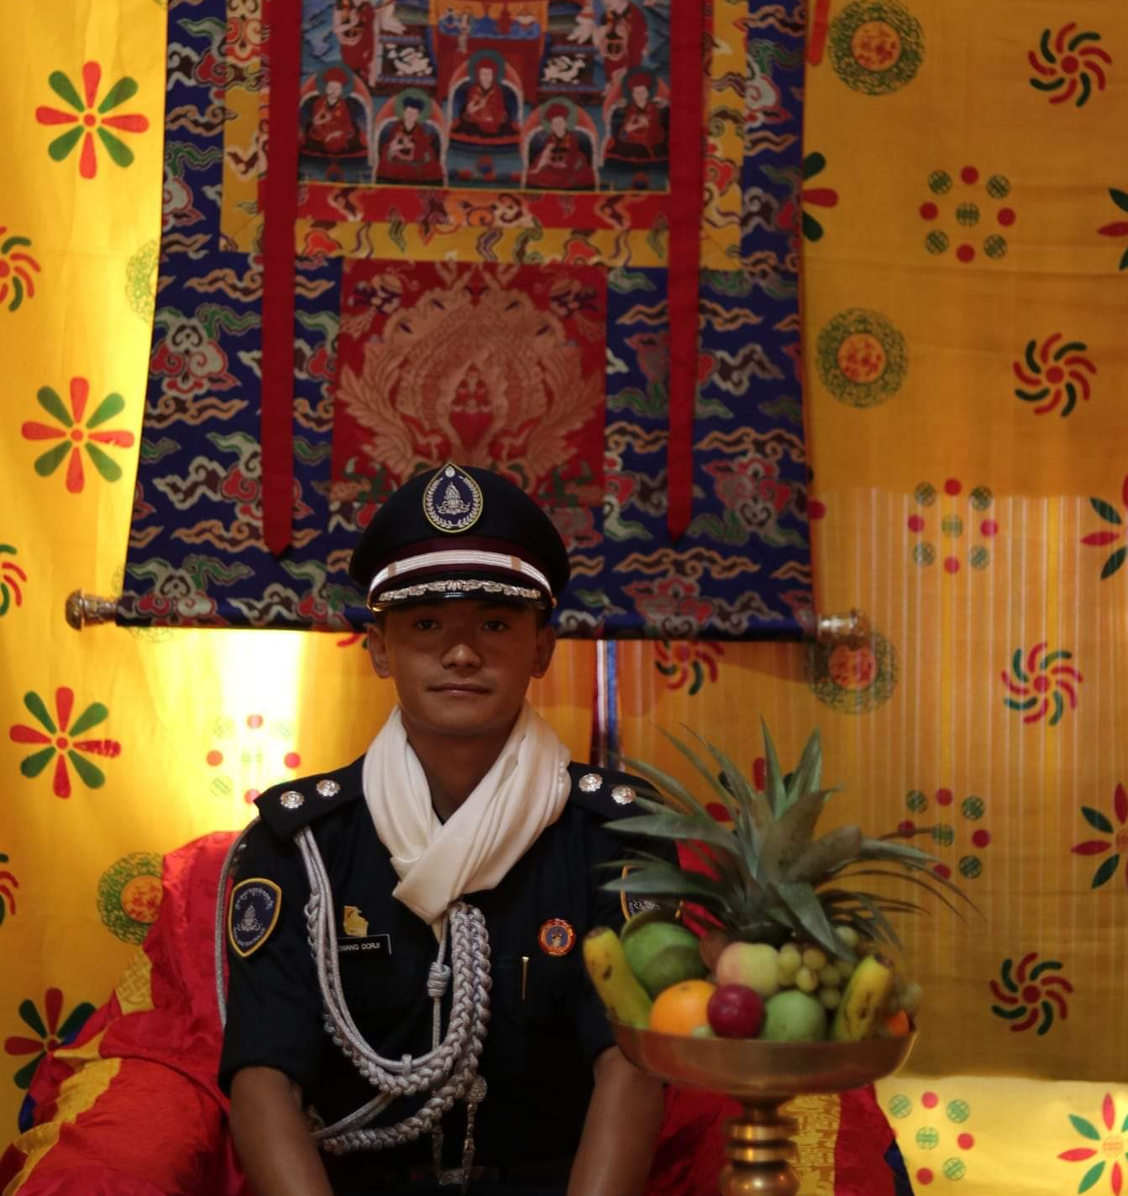
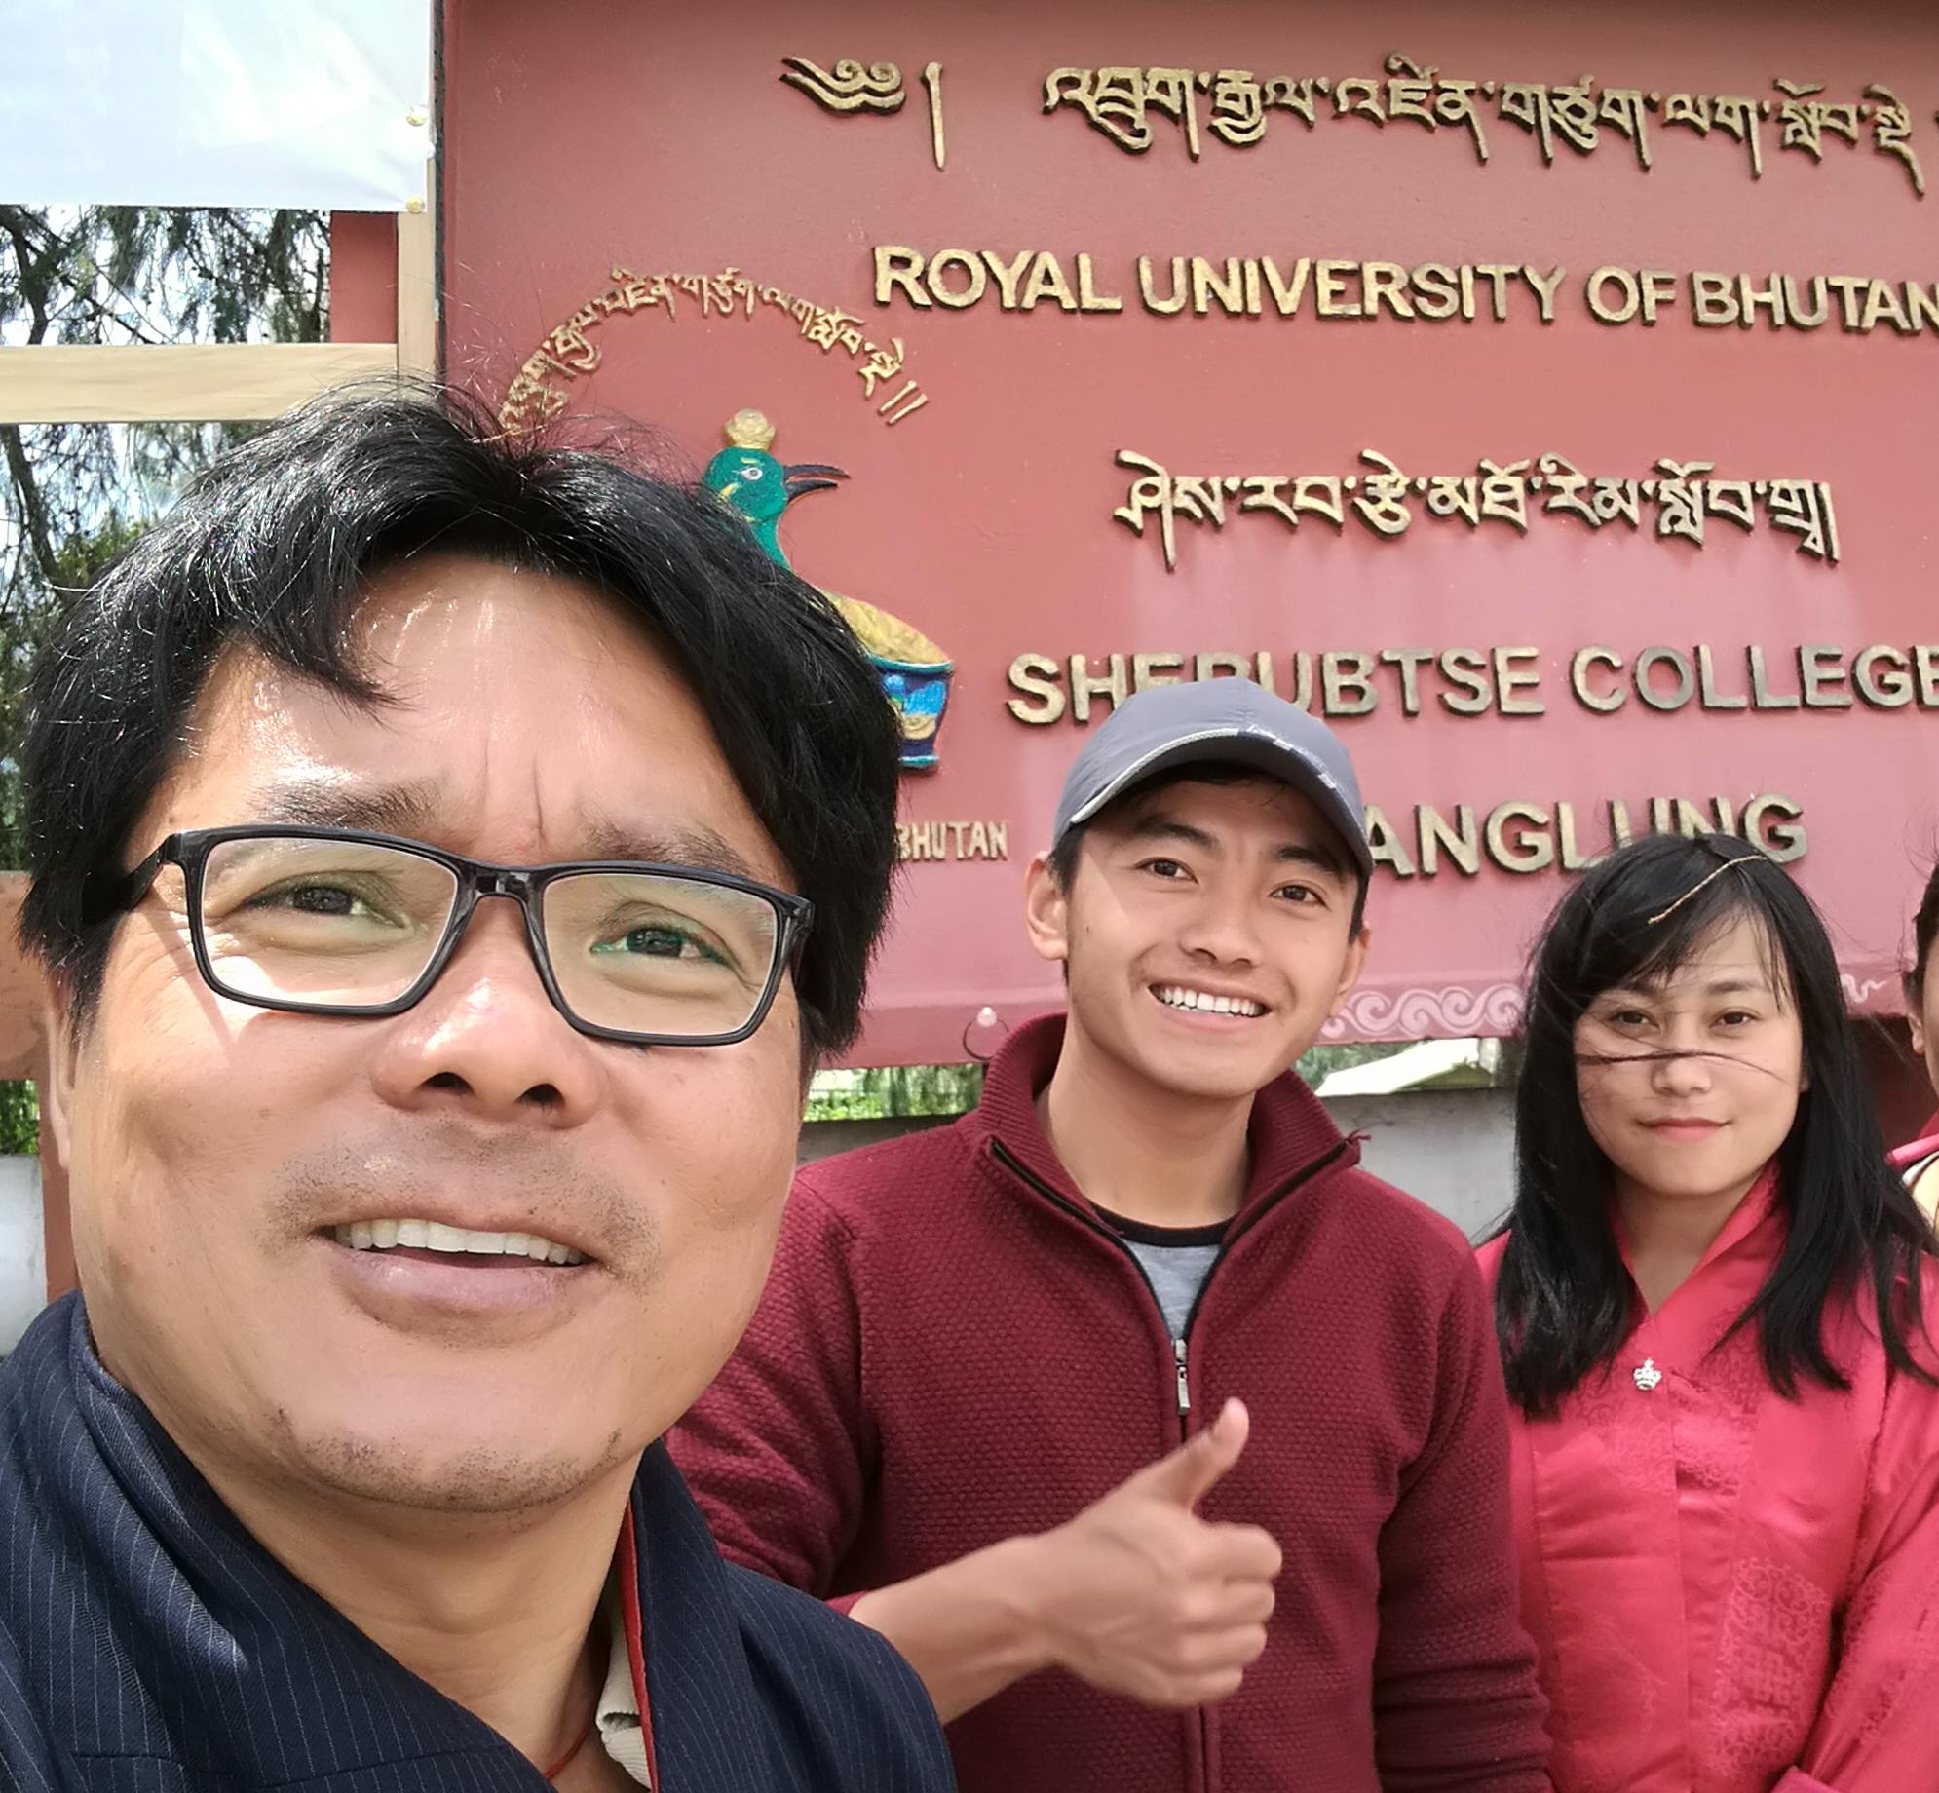
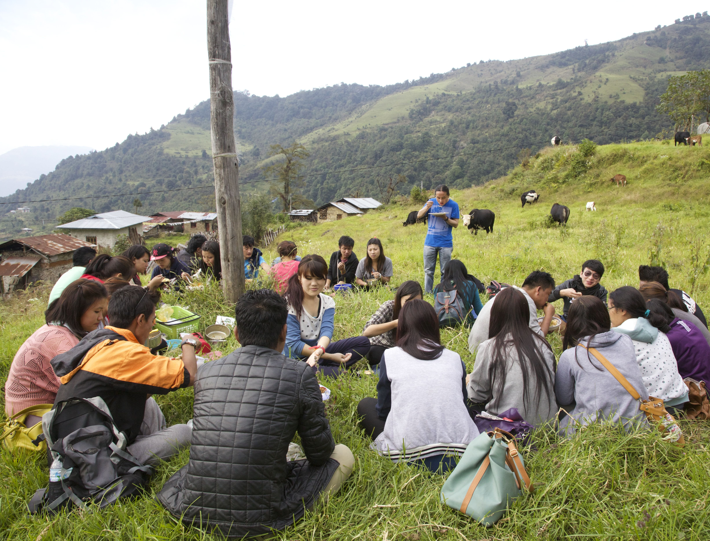

Slide 5
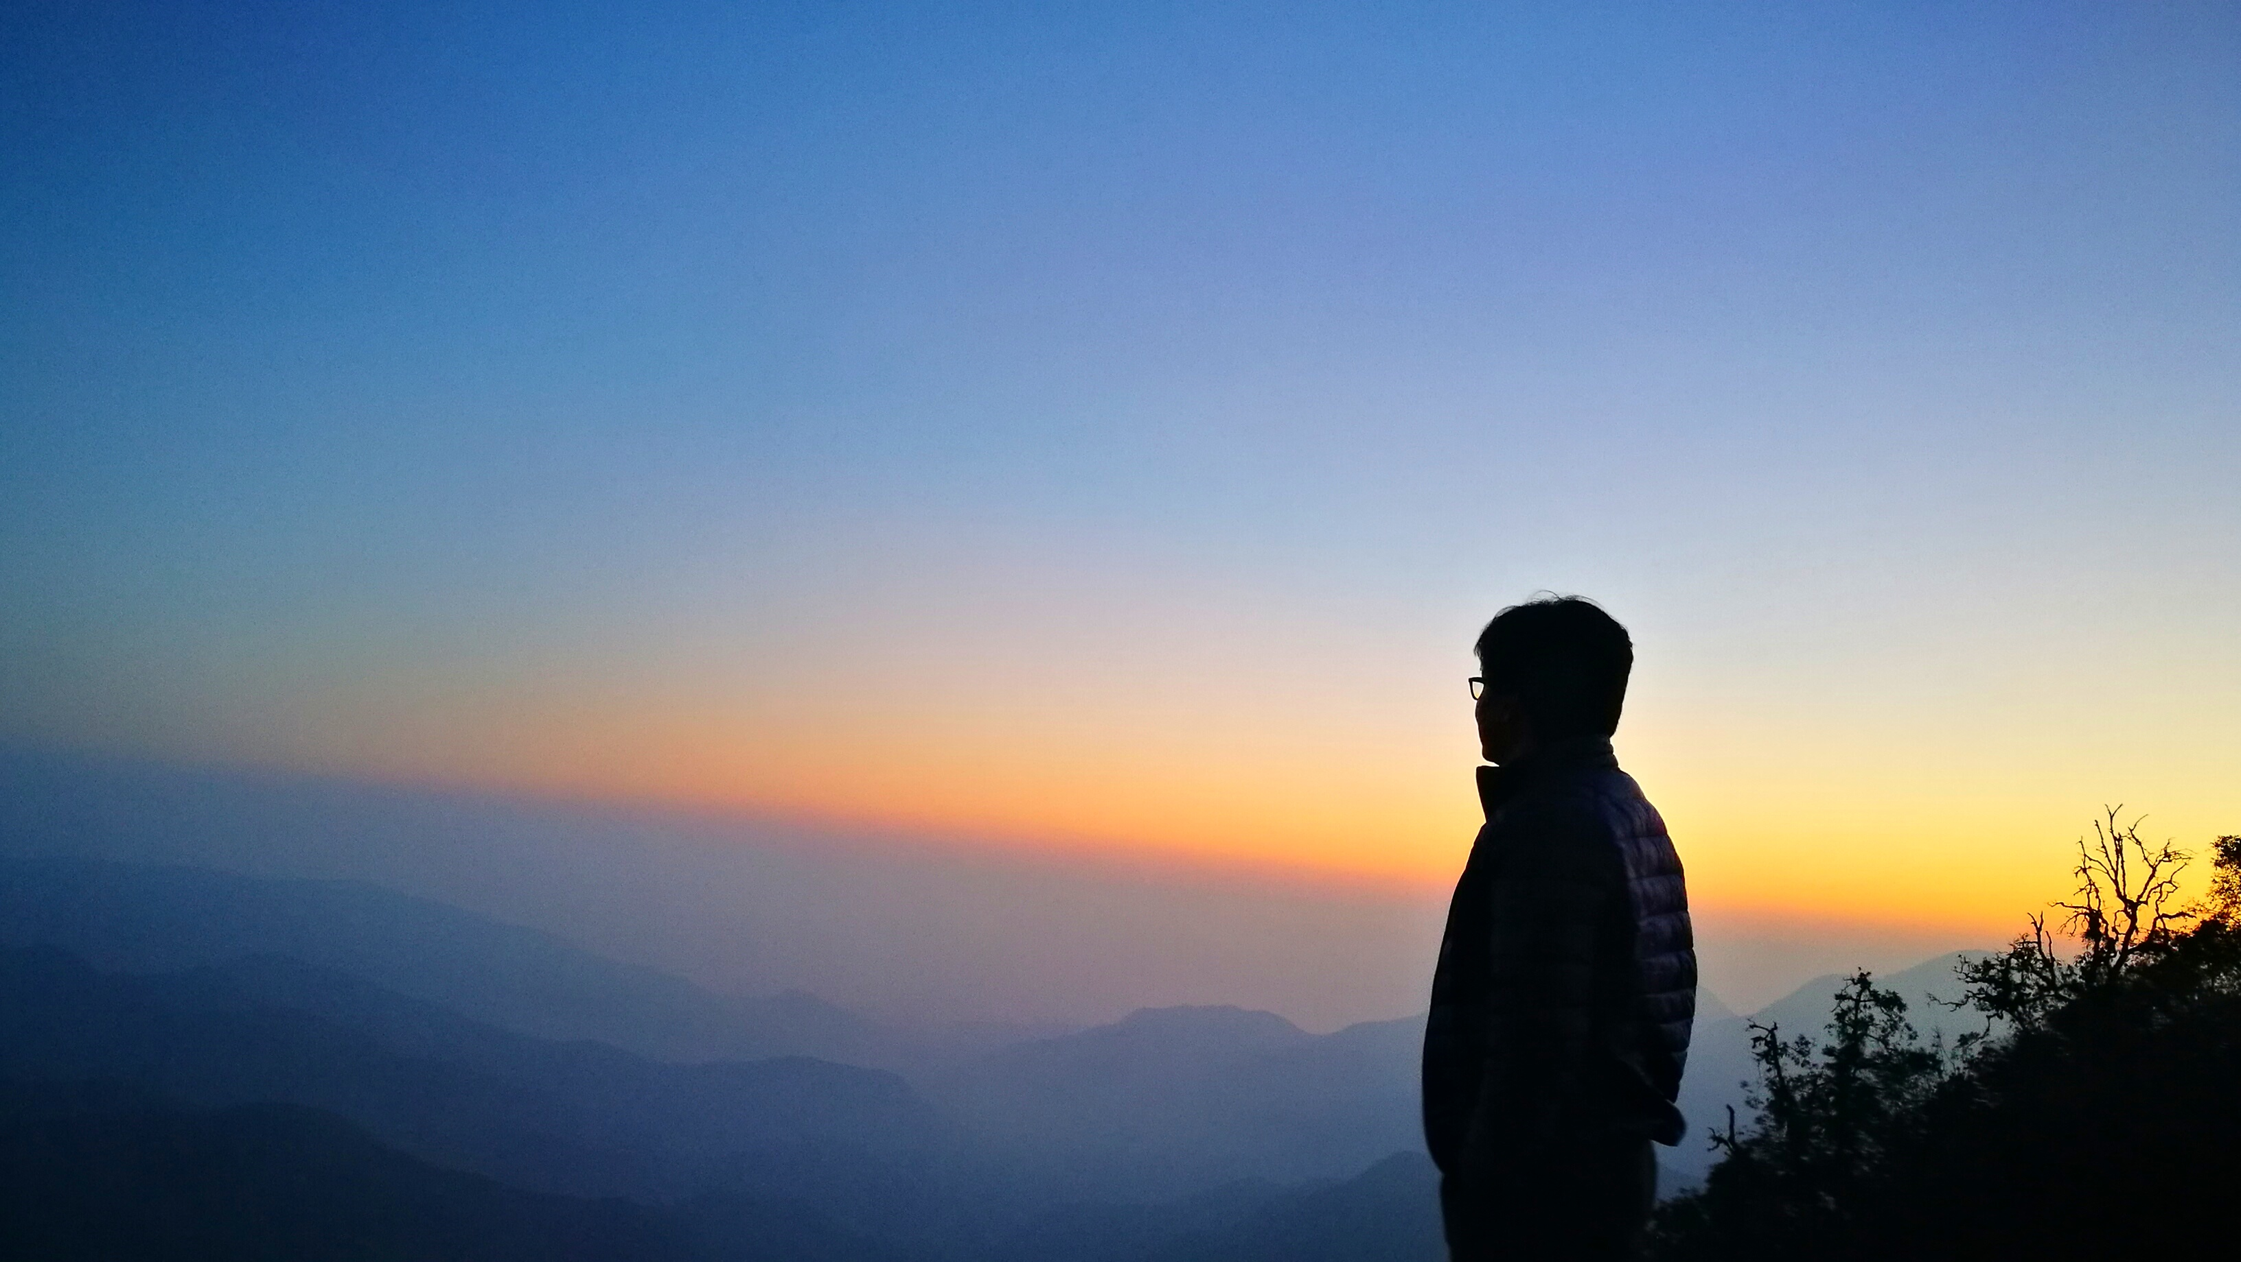
What makes a good teacher?

Slide 6

Lesson #1
Teaching is not just about curriculum
  Good curriculum + bad teacher = bad students
  Our curriculum too prescriptive

Slide 7
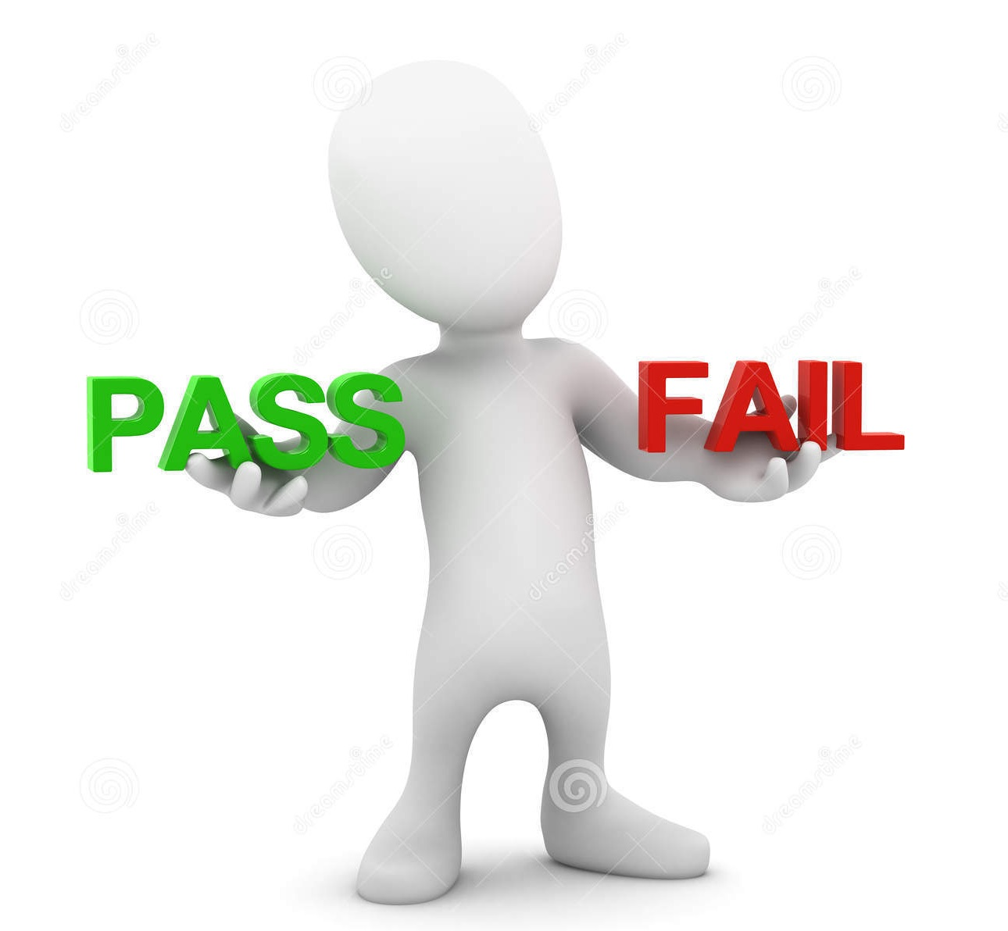
Lesson #2
A teacher has to recognize each student as an individual (and not as a batch/class)
  Get over the hangover from the Industrial Revolution model of education – pass/fail, batch, class, completion, grading

Slide 8
Lesson #3
No learning takes place where a teacher is stressed, unmotivated or is unskilled
  Quality of education = quality of teachers
  To be a teacher is to be a good parent

Slide 9
Lesson #4
No such thing as 21st century skill
  This era is different from the previous eras – fast, cruel, competitive, global
  How we prepare our children for their lives?

Slide 10
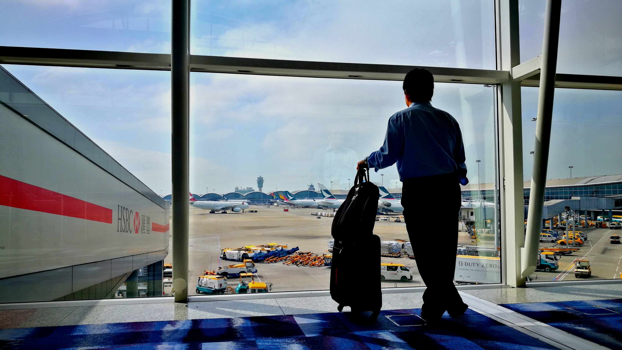
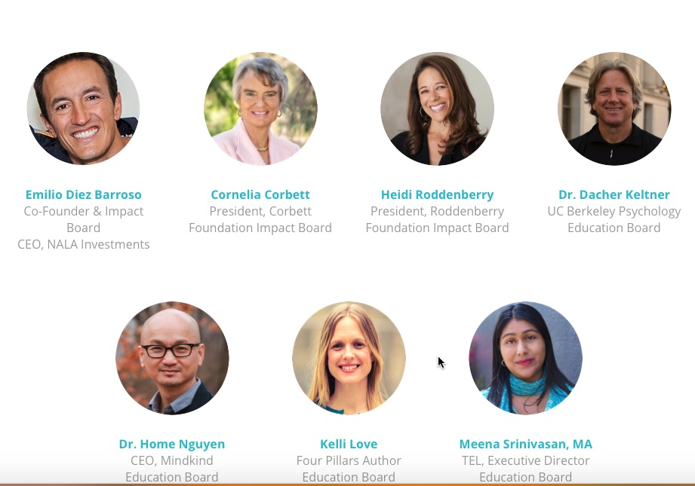
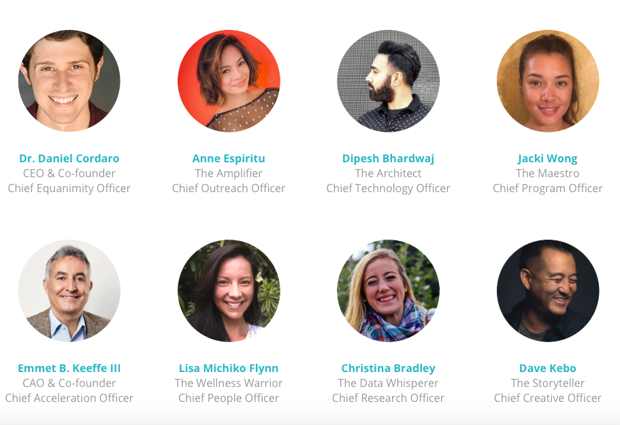
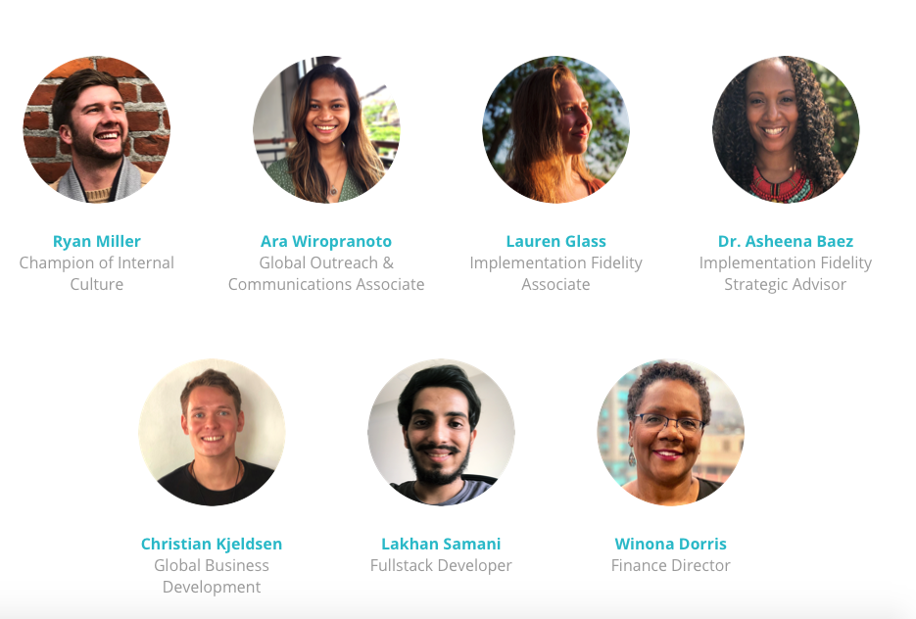
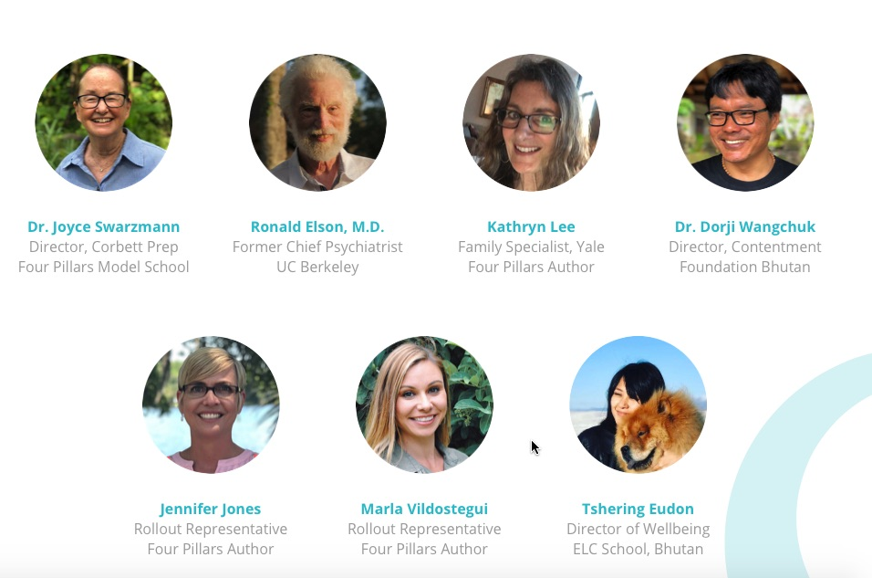

Slide 11
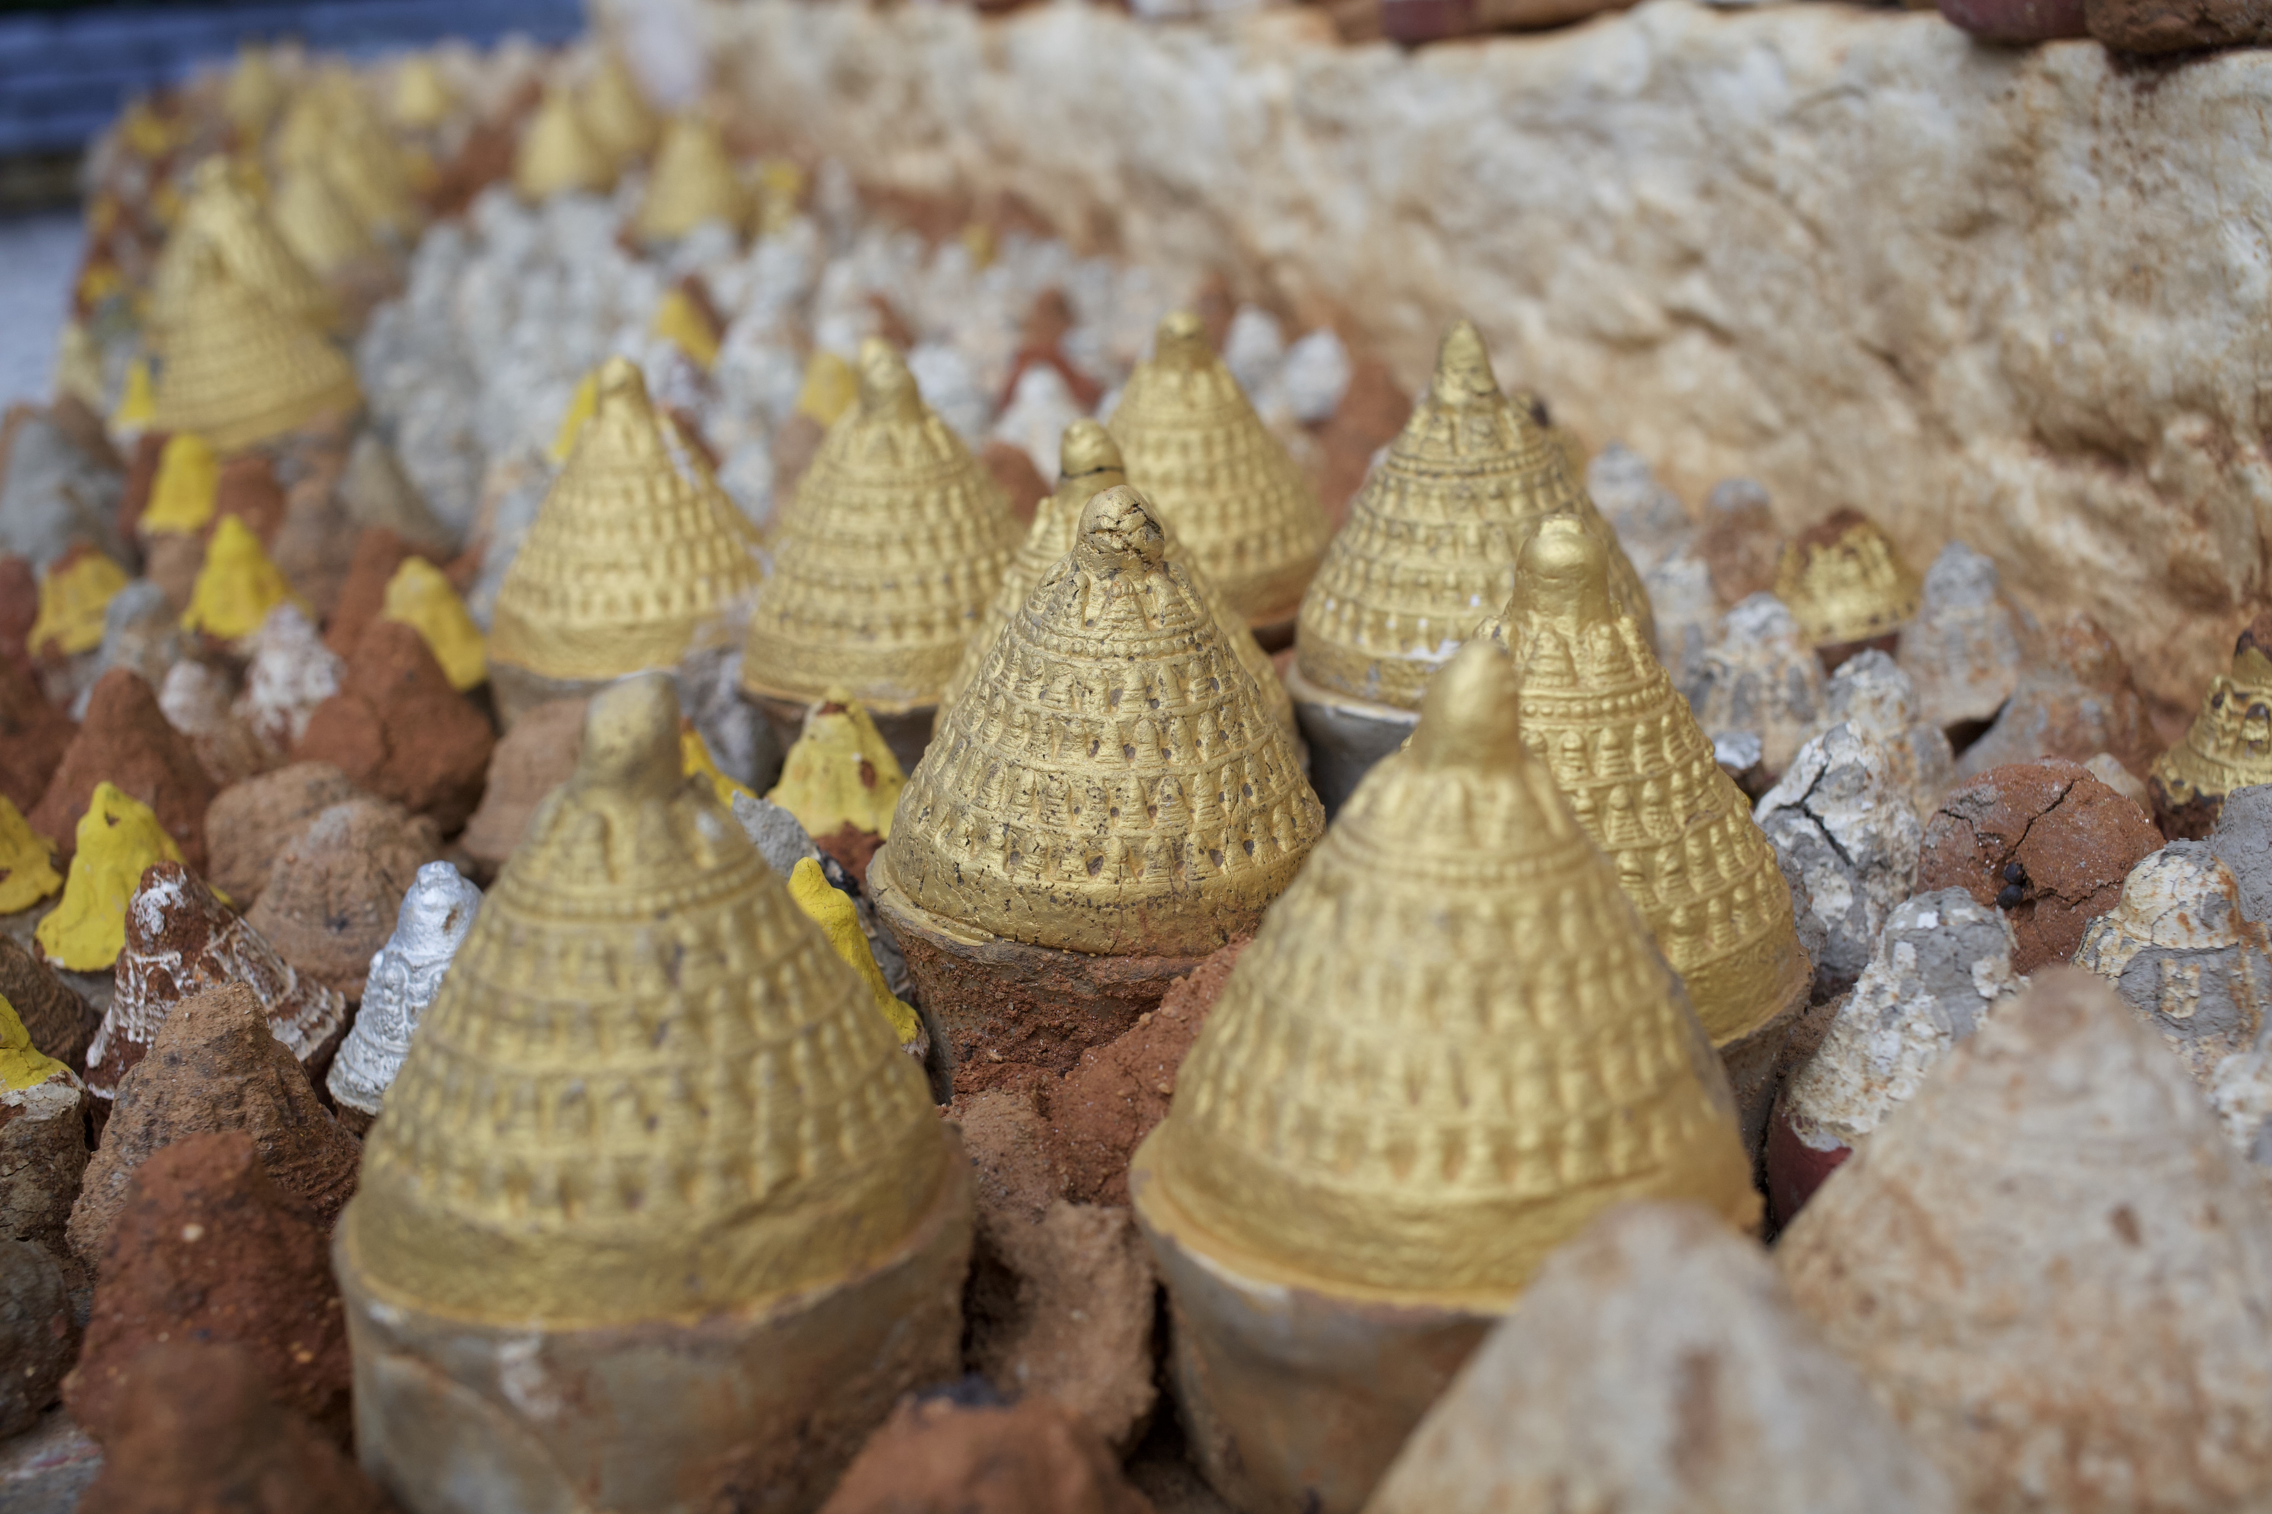
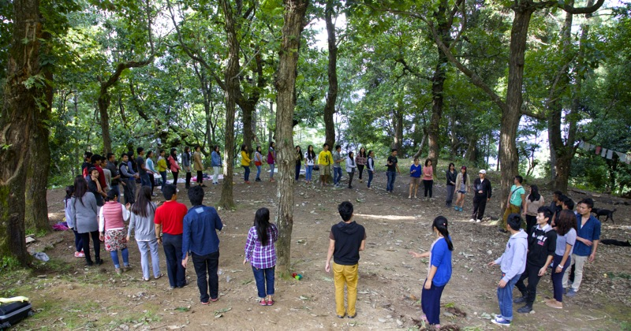
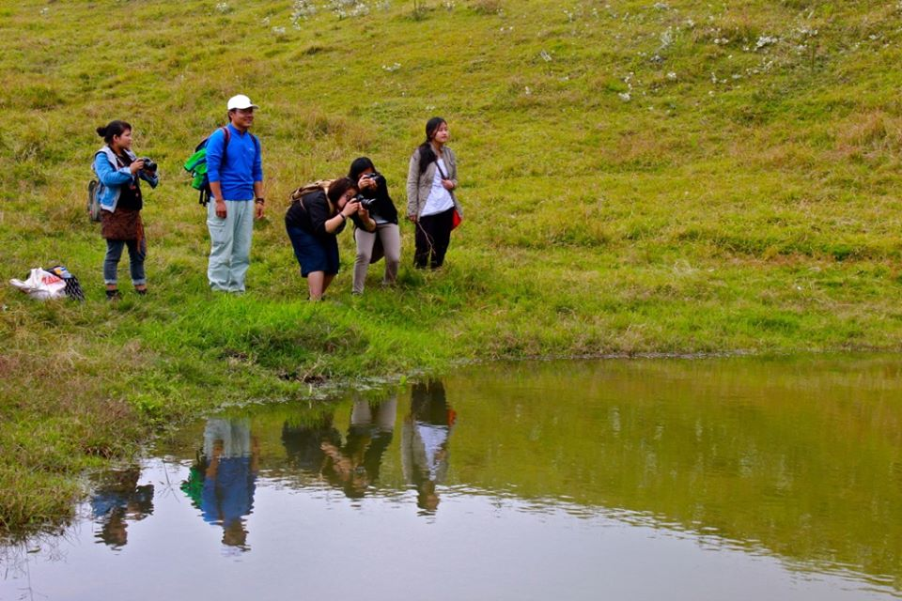
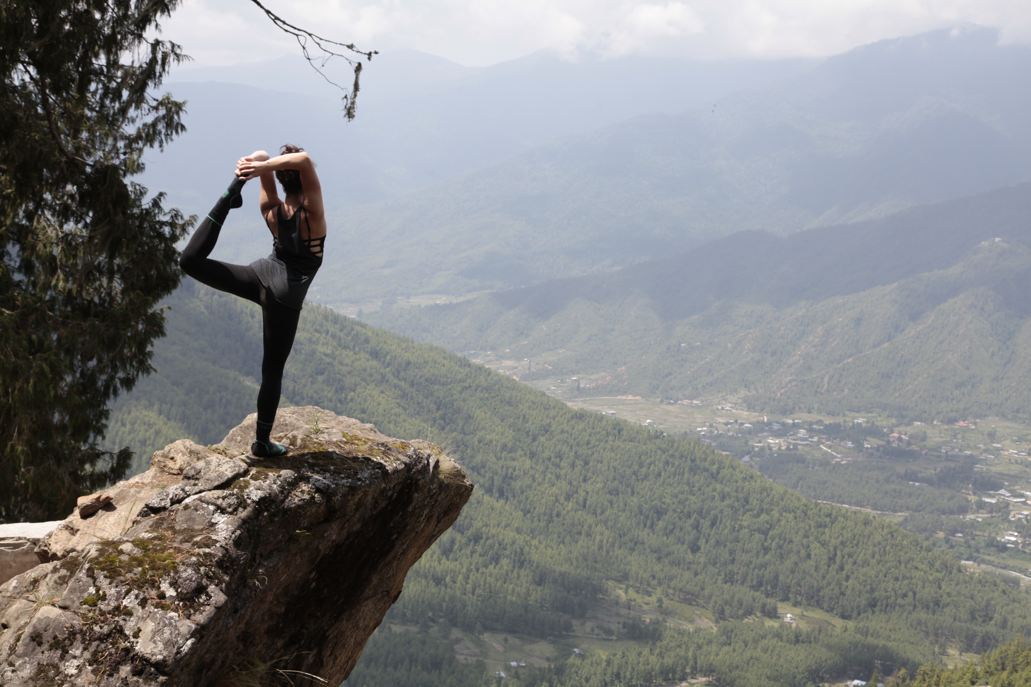
Four-pillar Wellbeing Curriculum
Mindfulness: cultivates non-judgmental attention to the present moment; an important aspect of developing calmness, focus, & self- awareness
Community: lets us bring out the best in each other by bringing out the best in ourselves. Create safe, healthy classrooms using positive psychology.
Self-curiosity: empowers students and staff to cultivate emotional intelligence, positivity, self-awareness, and the ability to understand the emotions of others.
Contentment: helps cultivate a sense of unconditional acceptance and appreciation for all experiences, as well as improving creativity and psychological adaptability.

Slide 12
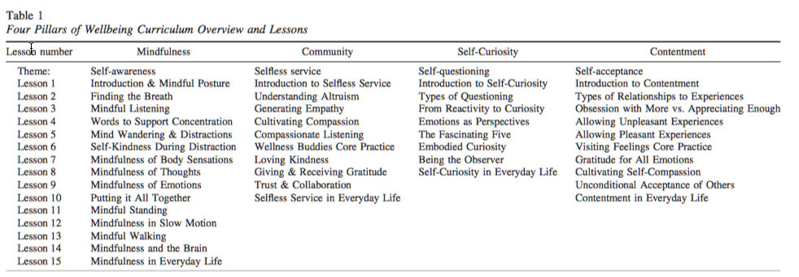
Four-Pillars Wellbeing Curriculum
Overview

Slide 13
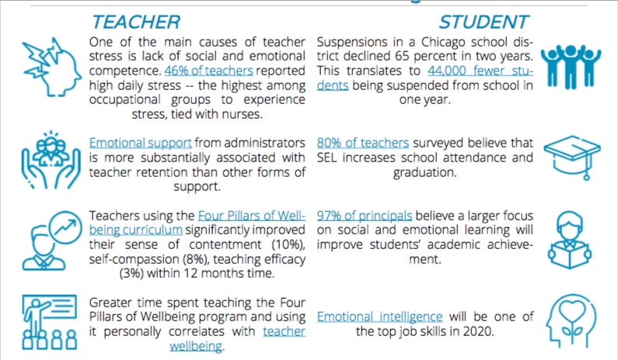
Stats from the schools

Slide 14
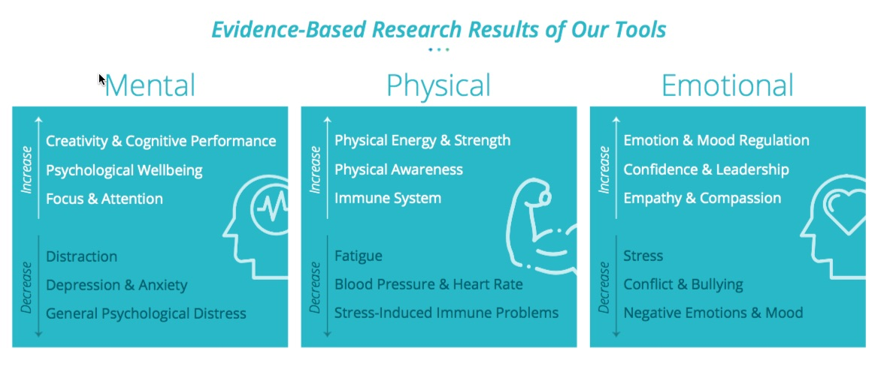
Some more stats

Slide 15

When lost, turn back and trace your footsteps
Who are we? We do we come from? What do we hold dear as Bhutanese?

Slide 16
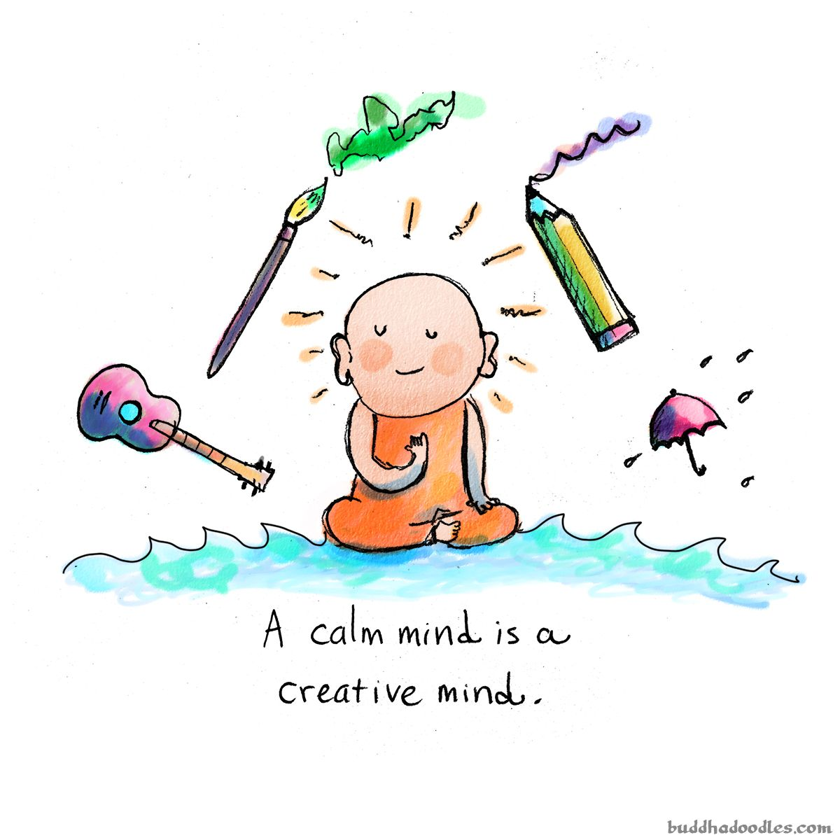
What did your mom tell you?
Know the limits (tsham tshay)
Take care of your mind (sem)
Think as community (mang)

Slide 17
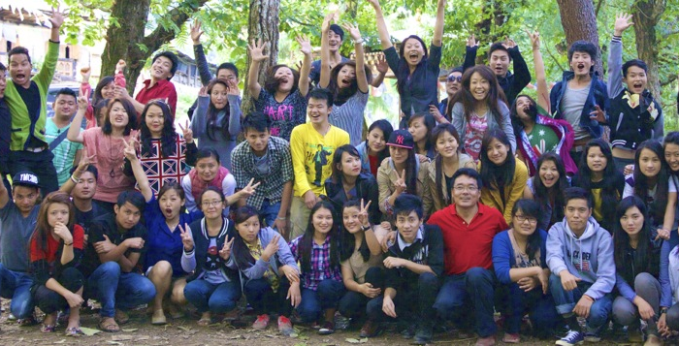
We Bhutanese
Uphold our timeless Values
Are adaptable and positive
As a country there is a Vision (GNH)

Slide 18
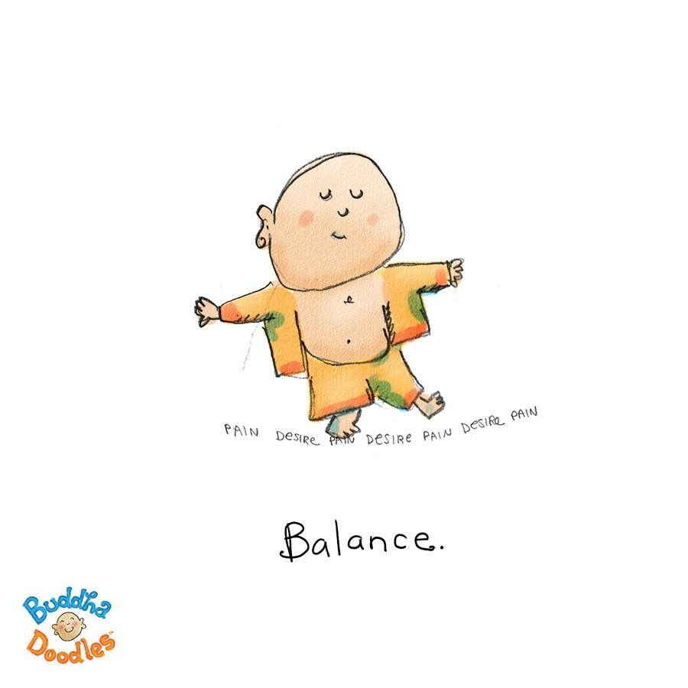
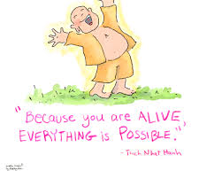

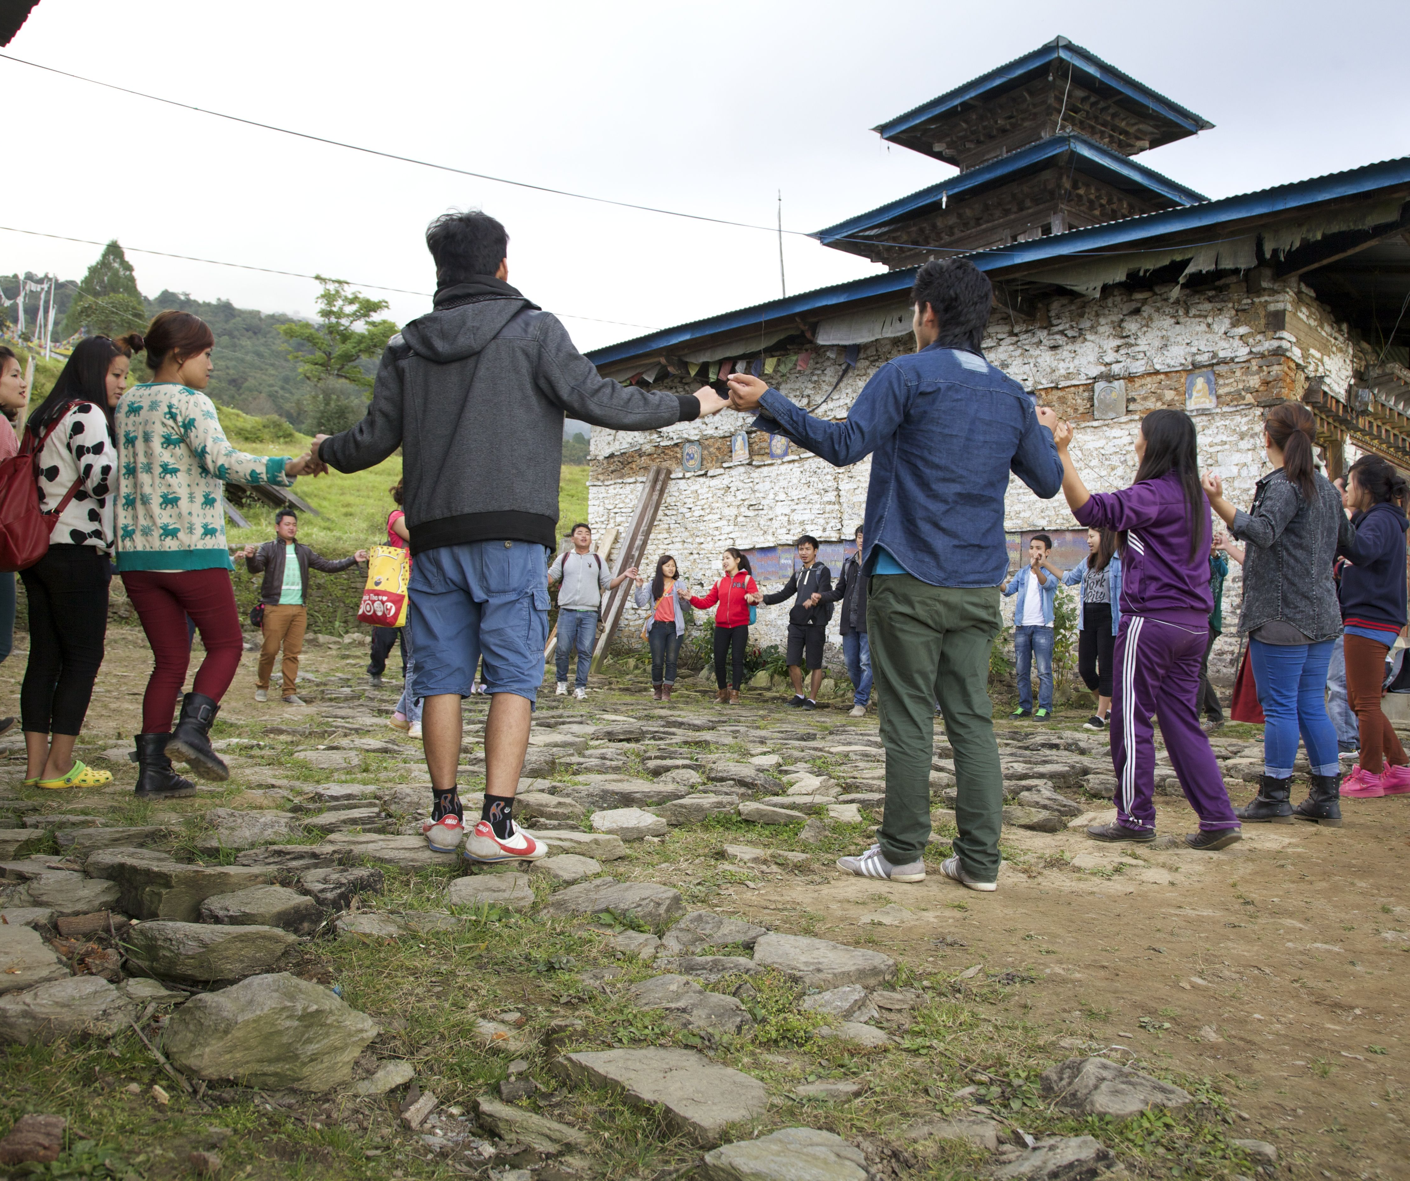
Wellbeing Tools for Teachers
tsham tshay
tsewa
Sem – Mindfulness/self-awareness
Mang -Community/harmony
Tsewa - Self-care/growth
Tsham Tshay -Contentment/balance
sem
mang

Slide 19

Way forward
Teachers have to be put at the center of education system
Need to look beyond their physiological needs - at their intellectual and emotional growth and practices
Wellbeing Tools for Teachers (WBTT) could provide the skills for teachers to be better teachers - and good human being
WBTT marries the traditional Bhutanese values with positive psychology = powerful tool to bring wellbeing to the class
If general wellbeing is achieved, isn’t that our Vision of GNH?

Slide 20

Contacts
www.dorji-wangchuk.com
dorji.wangchuk@yahoo.com
dorji@contentment.org
WhatsApp: +975 17110881
Facebook & WeChat: dorjiwangchukmac

