Slide 1
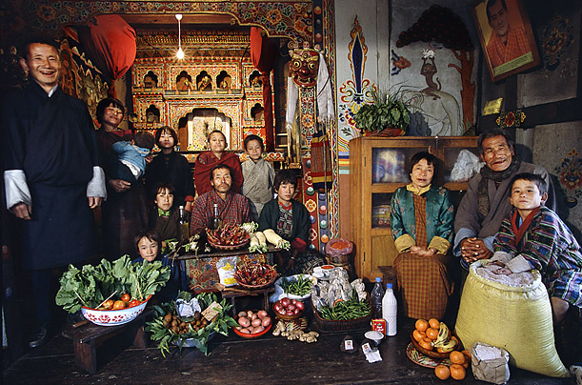

Kinship address system in Tshangla-lo of Bhutan - a rhetorical tool for community vitality and sustenance
Dr. Dorji Wangchuk
Chokshey/University of Macau

Slide 2


THIS PAPER
Explores kinship terminology in Tshangla-lo
How it contributes to family and community
Share my observations on linguistic policies

Slide 3
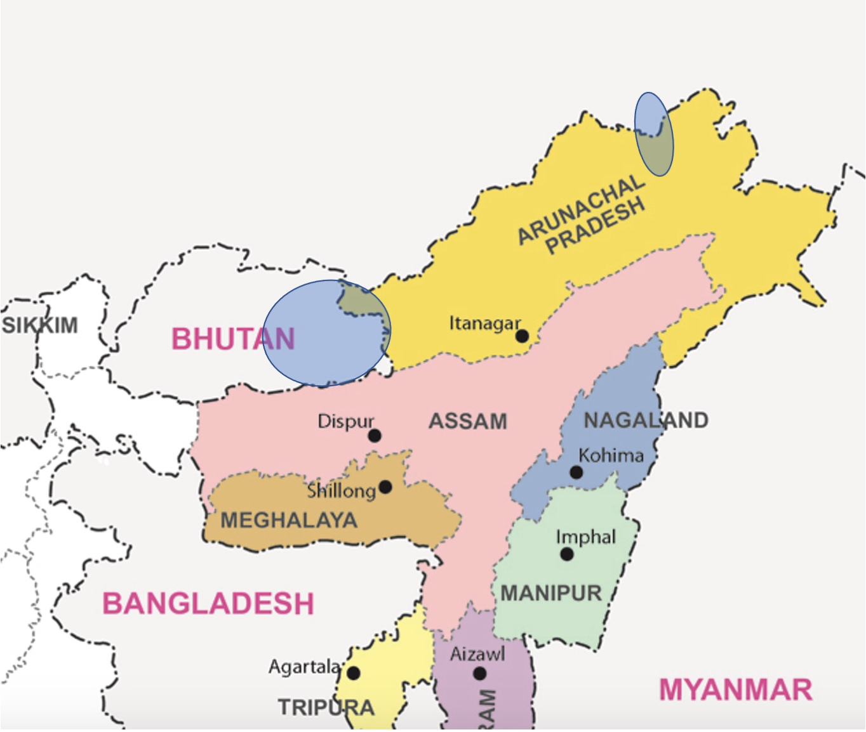
Definitions
Kinship address is a system whereby a member of a family refers to another member with an established terminology
  Mother – Ai - Ama - Madre

Slide 4
Context & background: Bhutan
Area: 38,000 sq. km.
Population: 700,000 speaking 21 languages
GDP: USD 2.00 billion
Geography: Mountainous
Major source of revenue: Hydropower
Major economic activity: Farming
Medium of instruction in schools: English
TV and Internet: 1999
Mobile phones: 2003

Slide 5
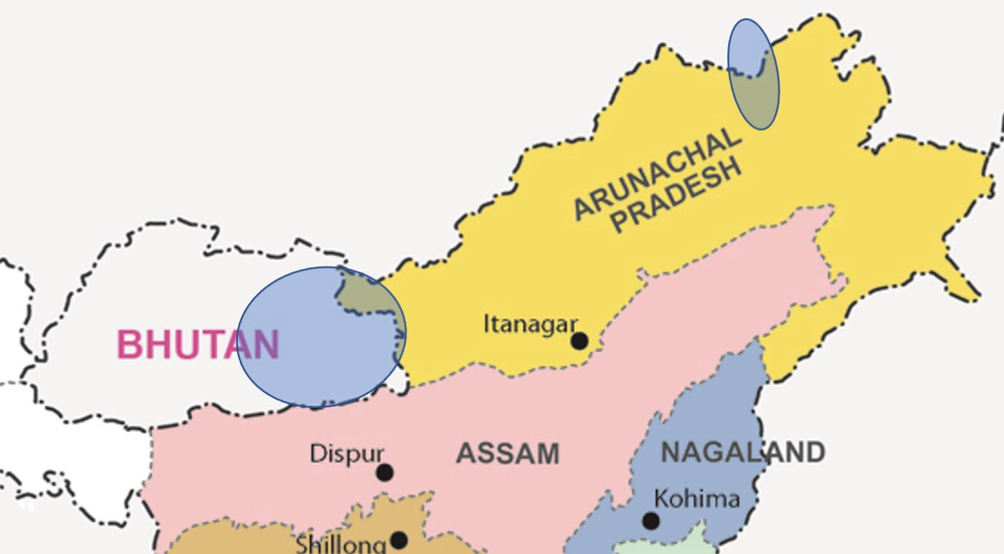
Context & background: Tshangla-Lo
Tshangla (aka Sharchop) is largest ethnic group of Bhutan.
In Arunachal Pradesh and in China they are referred to as monpa, moenba, shar-pa
Native Tshangla speakers: 200,000 (Bhutan)
50-60,000 (India)
5 - 10,000 (China)
No written script

Slide 6
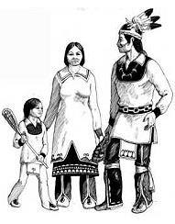
Literature review
Kinship structure: studied first by Lewis Morgan (1873) and by scholars such as Lowie, Kirchhoff, Spier
    Six typology: Sudanese, Inuit, Hawaiian, Iroquois, Crow and Omaha
    Iroquois tribe – father/brother, mother/sister same terms.
Linguistic relativism: Language you speak influence one’s thoughts and worldview

Slide 7
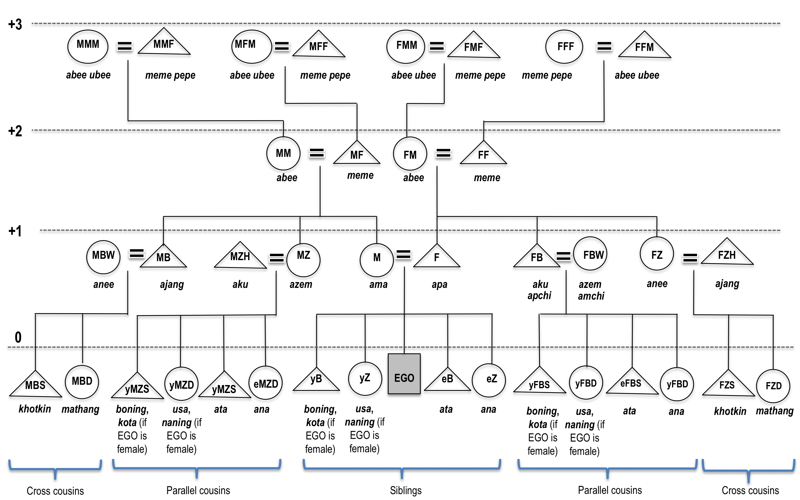
Kinship structure - I

Slide 8
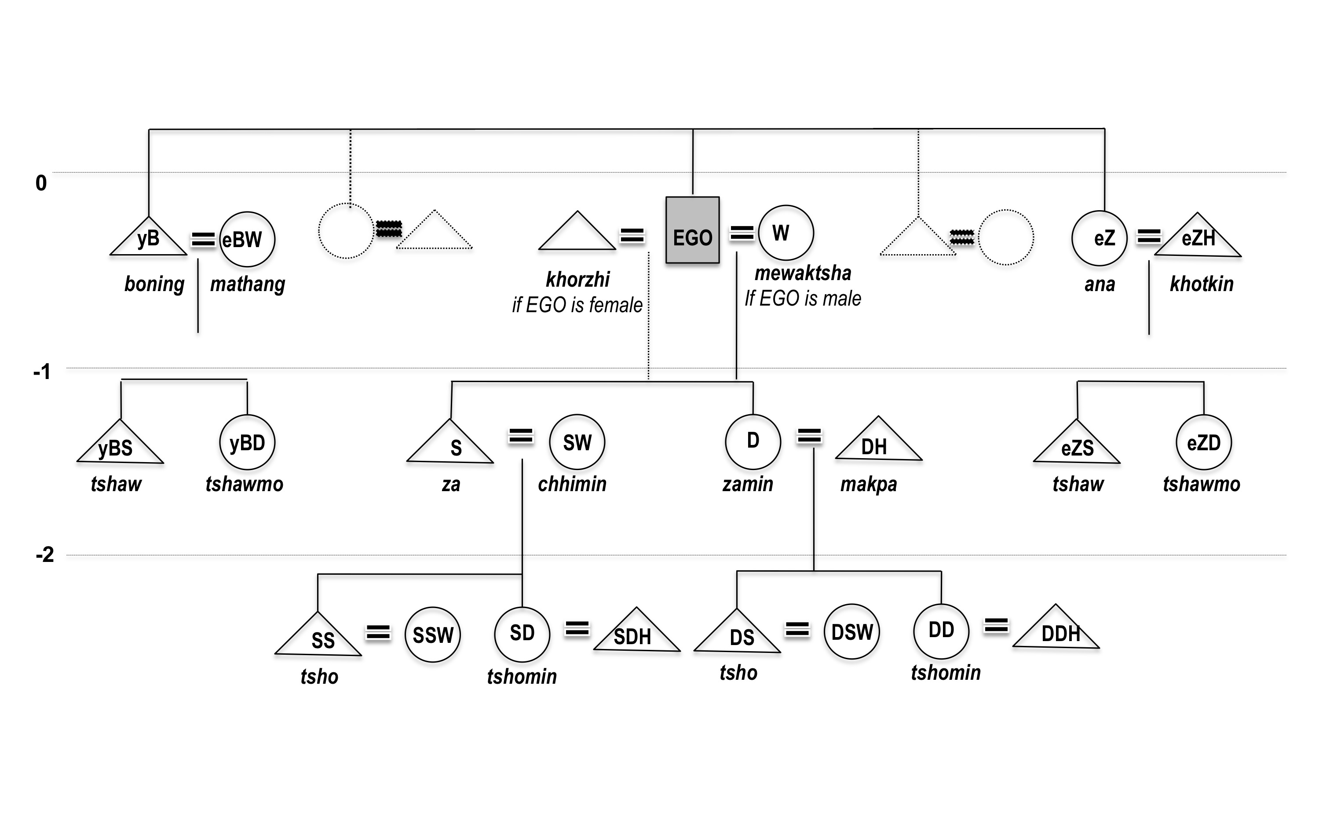
Kinship structure - II

Slide 9
Finding: structure
Structures have the Inuit typology
Cross-cousin marriage less common now
Parallel cousins enjoy the same status as siblings
Consanguineal and affinal kins enjoy the same status within family/clan - resulting large extended family

Slide 10
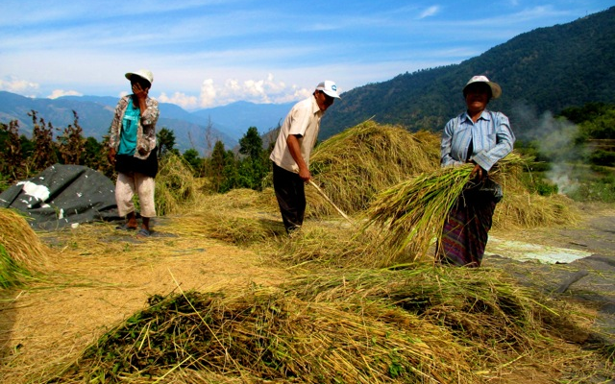
Findings
Kinship address system stronger in rural areas than urban
Tshangla speakers have more relatives & stronger clans
Addressing elder members, nature and supernatural with a structured pattern/term

Slide 11
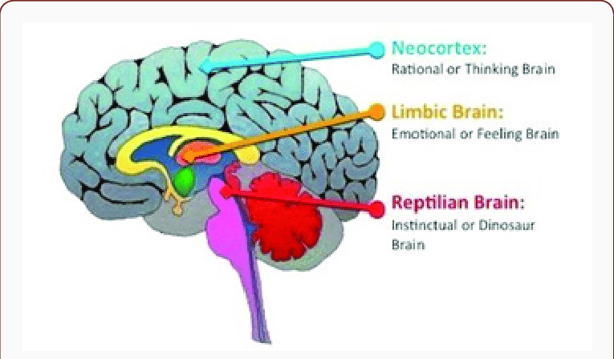
Discussion
Community building
    Not just for referential function but also for emotional links and maintaining relationships. Socialization of children
    Markers of personal, social and cultural identity. Cultivates sense of belonging
    Kinship term used on non-kin members, and family deity and village gods
Transmits values and wisdoms
    Linguistic relativism
    (E.g. Bodos are nature people)
    Wisdom sits in places (Basso, 1996)

Slide 12
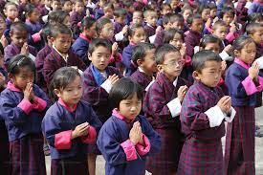
Linguistic policies and practices
All over the world, societies is changing
Locally rooted, globally competent…..
(HM King of Bhutan)
My own story – not a dichotomic choice

Slide 13
REFERENCE
Morgan, L. H. (1871). Systems of consanguinity and affinity of the human family (Vol. 218). Smithsonian institution.
Read, D. (2013). A new approach to forming a typology of kinship terminology systems: From Morgan and Murdock to the present. Structure and Dynamics, 6(1).
Sandel, T. L. (2002). Kinship address: Socializing young children in Taiwan. Western Journal of Communication (includes Communication Reports), 66(3), 257-280.
Tshering, K (2013). Kinship and language documentation in Bhutan. [Powerpoint slides]. Retrieved from https://scholarspace.manoa.hawaii.edu/bitstream/10125/26148/2/ 26148.pdf
Turin, M. (2004). Thangmi kinship terminology in comparative. Himalayan Languages: Past and Present, 149, 101.

